Slide 1
EXPLORING A GREATER EAST GRAND REGION ECONOMIC PLAN
Initial Project Team Meeting
May 9, 2019
Goal Setting & Priorities
A POWERPOINT PRESENTATION SUPORTING GOALS & PRIORITIES FROM APRIL 12, 2019 MEETING

Slide 2
Why are we here?
“Asset Based Economic Development”
“Asset – based economic development can help small towns and rural communities leverage their existing assets into economic opportunities.”
Assets; Anything of value in the Community or Region: People (skills, knowledge, demographics) – Financial (Private, public, philanthropic)– Infrastructure (Schools, Medical, Roads, Government) – Community Services (Food, Energy, Social, Religious)– Businesses (Lodging, Dining, Recreational) – Cultural & Heritage (Oral and written histories, native influence, pioneers, rural living) – Natural Resources (Land, Water, Forests, Trails) - Connectivity (Political, Economic, Institutional) – Organizations & Events (Lodge, Chamber, CORE, Garden Club, Summerfest, East Grand Adventure Race, etc)
“Building partnerships and working collaboratively are critical in leveraging resources, building support and in turning ideas and community assets into a successful long-term economic development plan.”

Slide 4
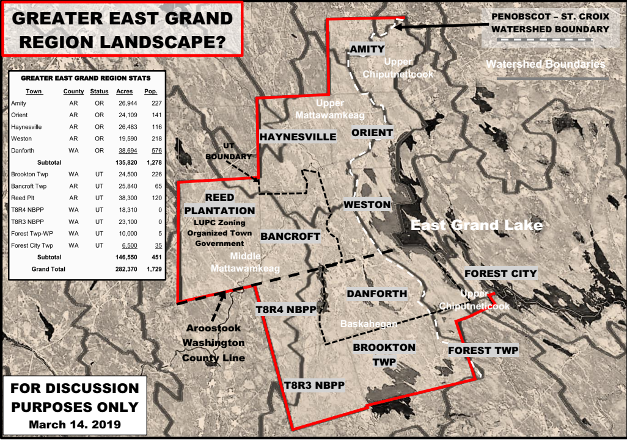
DEFINE THE PROJECT AREA?

Slide 5
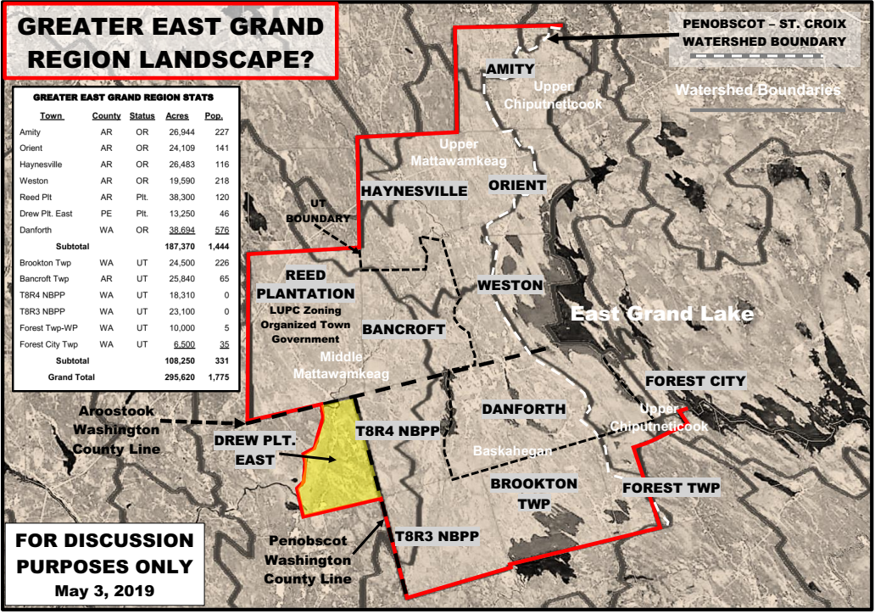
AGREEMENT ON PROJECT AREA?

Slide 6
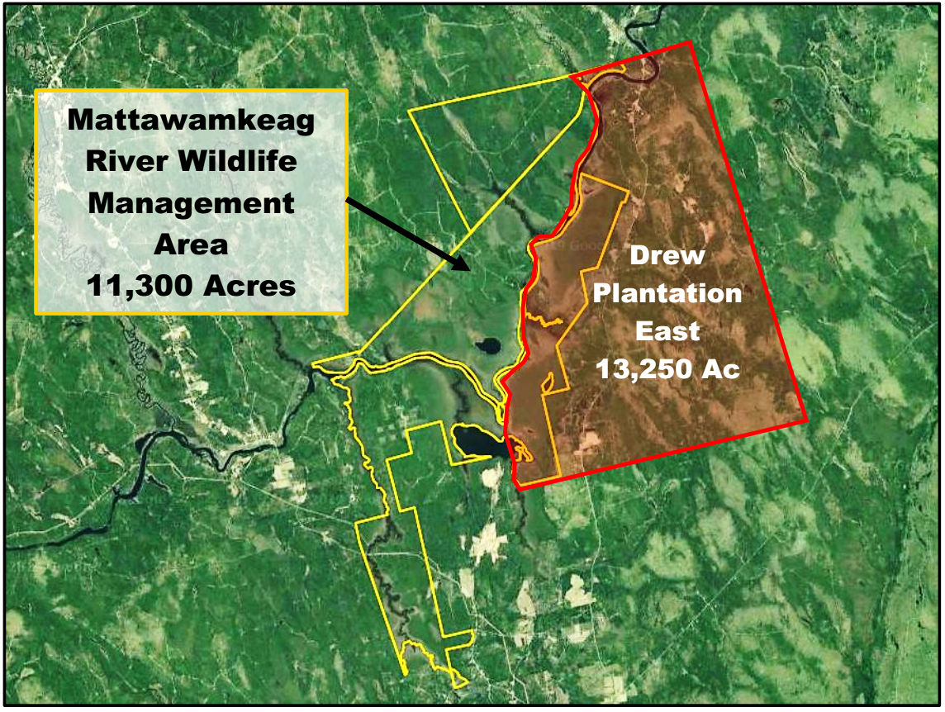
AGREEMENT ON PROJECT AREA

Slide 7
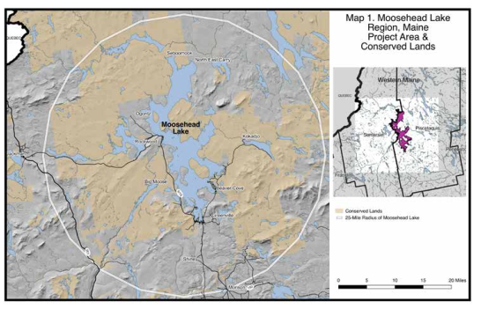
AN EXAMPLE: PROJECT AREA – 25 MILE RADIUS FROM CENTER OF MOOSEHEAD - 300,000 ACRES

Slide 8
#1
KEYS TO GOOD COMMUNITY COMMUNICATION
Quality local newspapers print and online
Local governments committed to transparency
Citizen opportunities to affect public policy
Access to information about quality of life
High speed internet available to all citizens
Local schools with high-speed internet
A public library, or other center for information
A majority of government services online
KUDOS TO NEW CHANGES AT COMMUNITY NEWS – THANK YOU!
https://www.pewinternet.org/2011/03/01/how-the-public-perceives-community-information-systems/

Slide 9
#1
RESULTS OF GOOD COMMUNICATION
If local government does well in sharing information people are more likely to be satisfied with civic life.
Citizens who think they can impact their community are more likely to be engaged in civic life.
Many times citizens cannot rely on a single source of information: They use Google, local websites, the phone, word of mouth, and their own informal networks.
Solution?: Advertise-advertise-advertise the go-to place for information and a community and/or regional calendar
https://www.pewinternet.org/2011/03/01/how-the-public-perceives-community-information-systems/

Slide 10
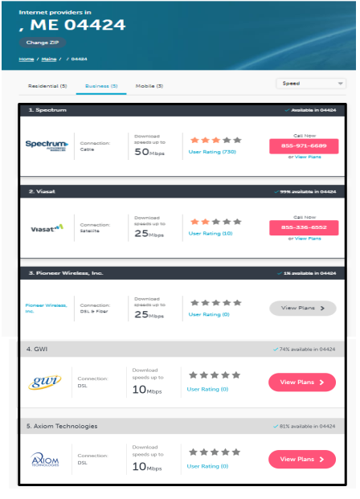
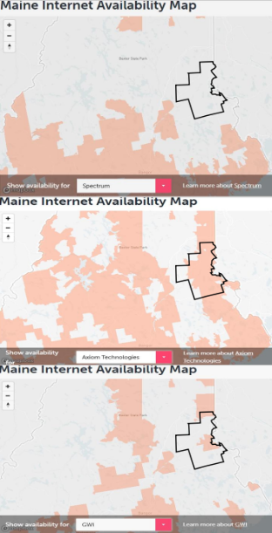
#2
INTERNET ACCESS
Are there Gaps in Service?
Who is the best provider?
Is DSL fast and secure enough?
Is fiber optic available?
Does the school have fiber optic?
Is it available to other users?
Interviews with current on-line users??

Slide 11
#3
HOW CAN WE COMPETE
“IN THE STICKS”?
https://cced.ces.uwex.edu/files/2015/04/Using-Quality-of-Life-Indicators-CIC-2014.pdf

Slide 12
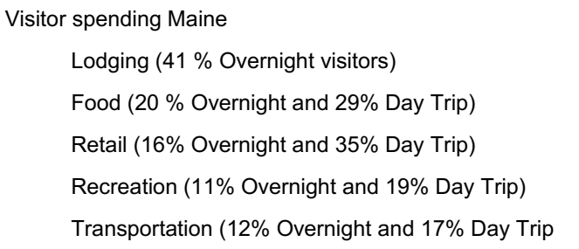
#4
FUTURE OF TOURISM MAINE WOODS (2018-2019)
Tourism in Maine Woods
https://future-iq.com/project/maine-woods-usa-2018/

Slide 13
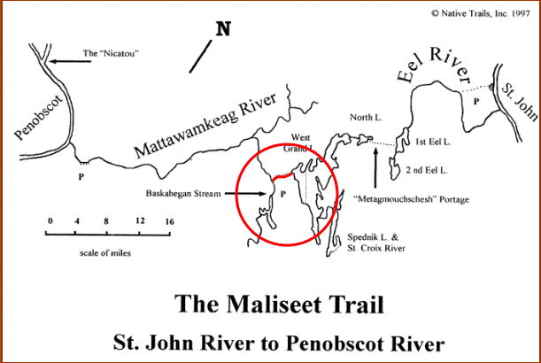
#4
Cultural heritage tourism “traveling to experience the places, artifacts, and activities that represent the stories and people of the past and present.”
A RICH HISTORY- A LEGACY?
Community Heritage Centers?
Kiosks?
Museums?
Native American History?
Early Settlement?
Existing written histories?
Oral histories?
Story telling?
Heritage Days?
Local Historical Societies?
Other?
Travelers say that trips are more memorable if they include a heritage activity where they learn something.
Heritage travelers stay longer and spend more money than other types of travelers.
Travelers are more apt to visit places with a strong community identity.
It is imperative to protect cultural heritage resources while drawing attention to them.
https://history.sd.gov/preservation/docs/CHTBenefits.pdf

Slide 14
#5
Branding Is The New Economic Development
Branding isn’t just a logo or tagline.
It isn’t smoke and mirrors or fabricating something out of nothing.
It’s discovering what truly makes an area unique -- even if it just lies in potential
Then building a platform and a strategy to attract others who share that same value and vision.
https://www.forbes.com/sites/forbesagencycouncil/2018/08/31/branding-is-the-new-economic-development/#a716d7977dc1

Slide 15
#5
BRANDING
Moosehead Lake Region
“Home of America’s Crown Jewel”
Greater East Grand Lake Region
“ Home of Maine’s Outdoor Heritage”
Greater East Grand Lake Region
“ Create a contest to fill in the Blank?”

Slide 16
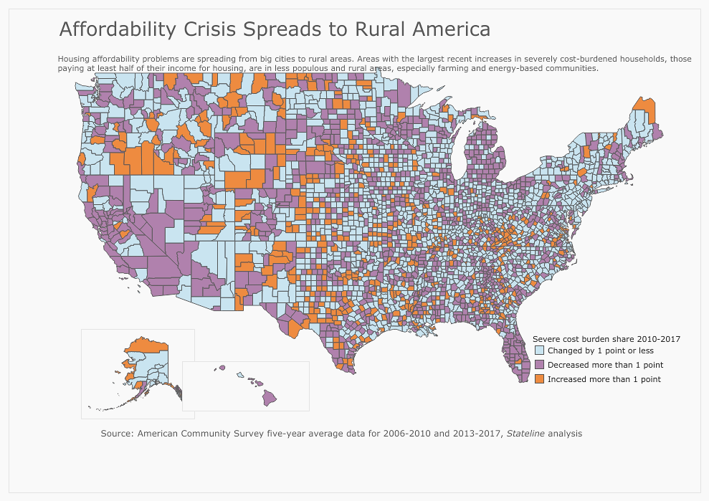
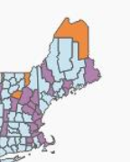
#6
HOUSING AFFORDABLITY CRISIS – ORANGE (SEVERE)

Slide 17
#6
SOME RECENT RURAL HOUSING QUOTES
“Housing is not affordable at 30+ percent of income.”
“Howland is most affordable - a median home at $65,750 but low prices are not a benefit at resale.”
“Maine places 9th worst among states”
“The private market is not building new affordable rentals”
“Long-term rentals has really, really gone down because of all the short-term rentals.”
“We see the rental market a result of wage stagnation, which has been decades in the making.”
“Affordable housing legislation's sponsor says even the $80 million won't meet the state's 'immense need.”

Slide 18
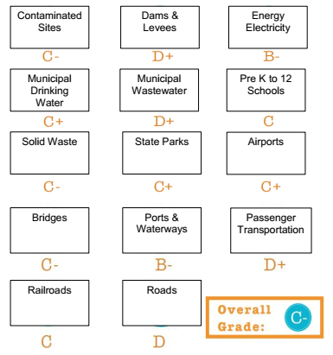
#7
SUSTAINING & IMPROVING BASIC INFRASTRUCTURE
Roads
Railroads
Bridges
Government
Water
Internet (Cable)
Phone (Cell)
Electricity
Schools
Health centers
Food
Energy
Religious
Maine is the most rural state by percentage of population.
MAINE

Slide 19
#7
SUSTAINING & IMPROVING BASIC INFRASTRUCTURE
EXAMPLES OF LOCAL INITITIATIVES
Danforth Revitalization
TCF Conservation – Development Plan Weston
WWLT Visitor Guide
EG Middle School Field Guide
Strategic Recreational Trails Planning
LIST OTHERS within and outside the Region?

Slide 20
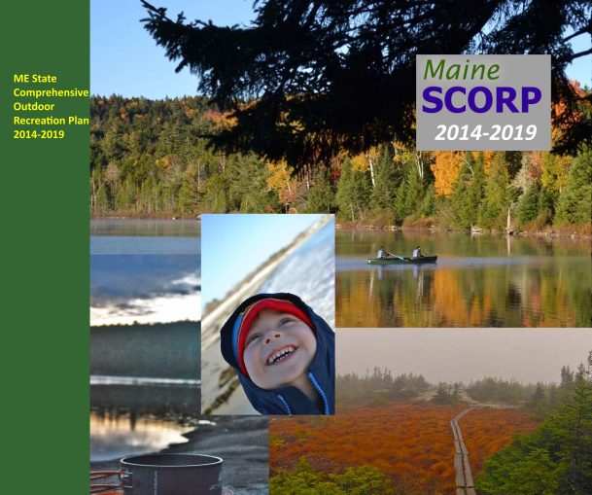
#8
MAINE STATE COMPREHENSIVE OUTDOOR RECREATION PLAN
Support initiatives involving multiple communities as a means of addressing tourism objectives.
Connect people of all ages with health and wellness benefits of outdoor recreation.
Support regionally connected trail systems in less developed areas.
Utilize “base camp” communities as centers of information for regional recreation
Use Land & Water Conservation Funds for new or expanded outdoor recreation opportunities. $40 million of LWCF matching dollars has been used for non-federal projects in Maine since 1966.
https://www.maine.gov/dacf/parks/publications_maps/docs/final_SCORP_rev_10_15_plan_only.pdf

Slide 21
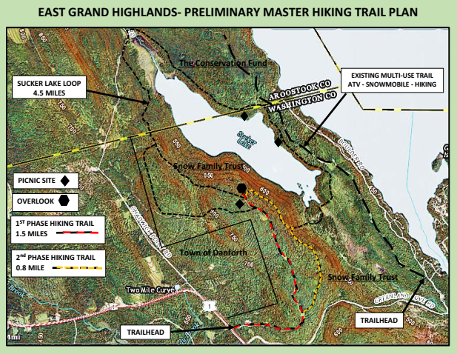
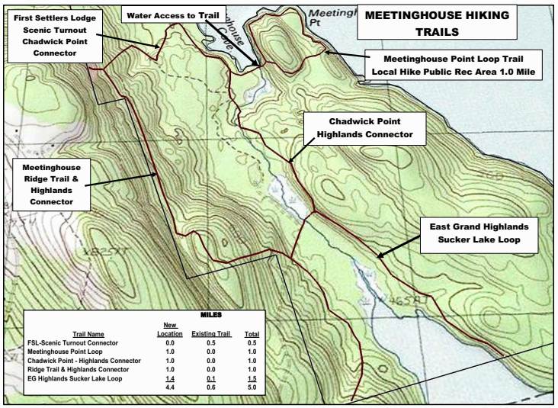
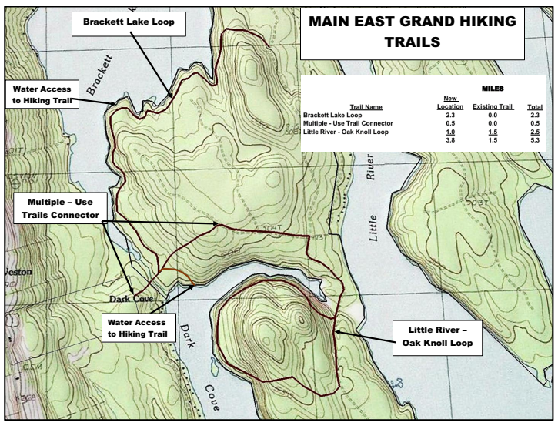
#8
Hiking Trails
East Grand Highlands 4.0 Miles (++)
Proposed TCF Weston
Meetinghouse
5.0 Miles
Million Dollar View
5.0 Miles

Slide 22
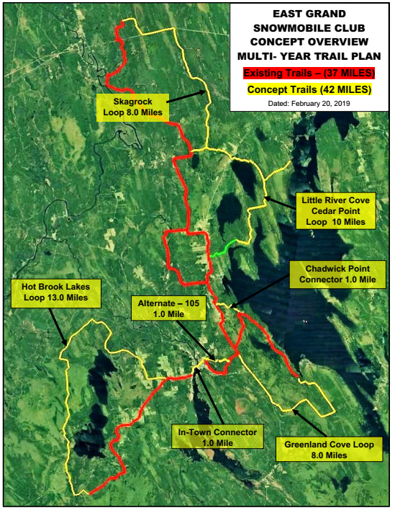
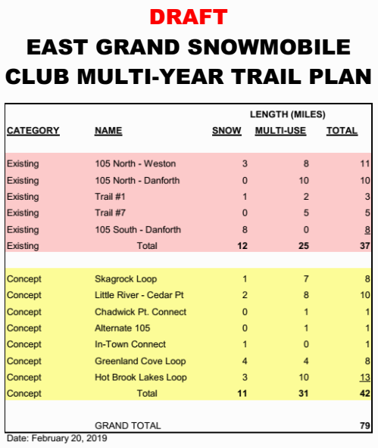
#8
Motorized Trails

Slide 23
#8
PROPOSED WATER TRAILS??
SUMMARY
15+ Potential Water Trails
123 miles of water
All Natural Flow
4 - Flat Water
7 – Flat to Flowing
4 – Flowing
9 – Subject to Moderate to Severe Dewatering

Slide 24
#9

Slide 25
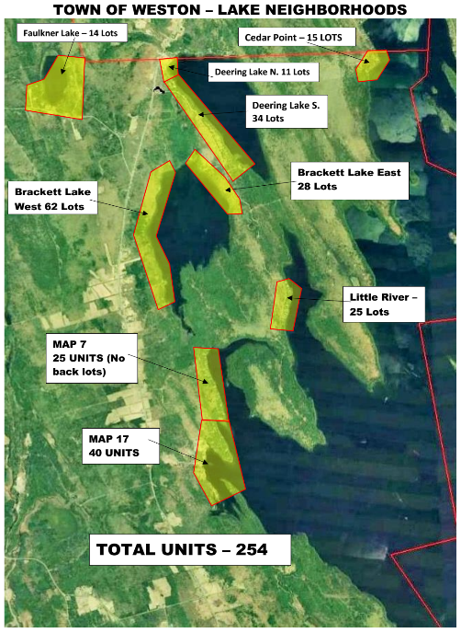
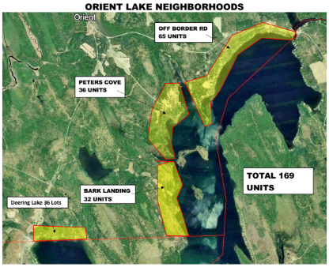
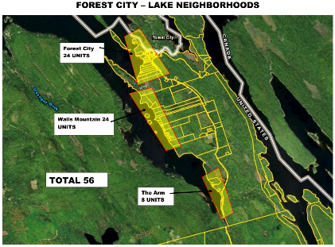

Slide 26
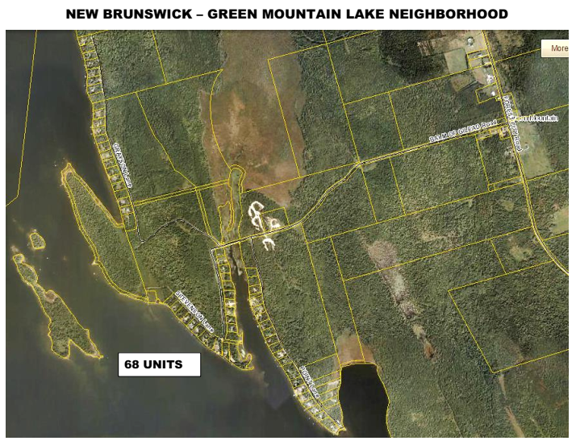
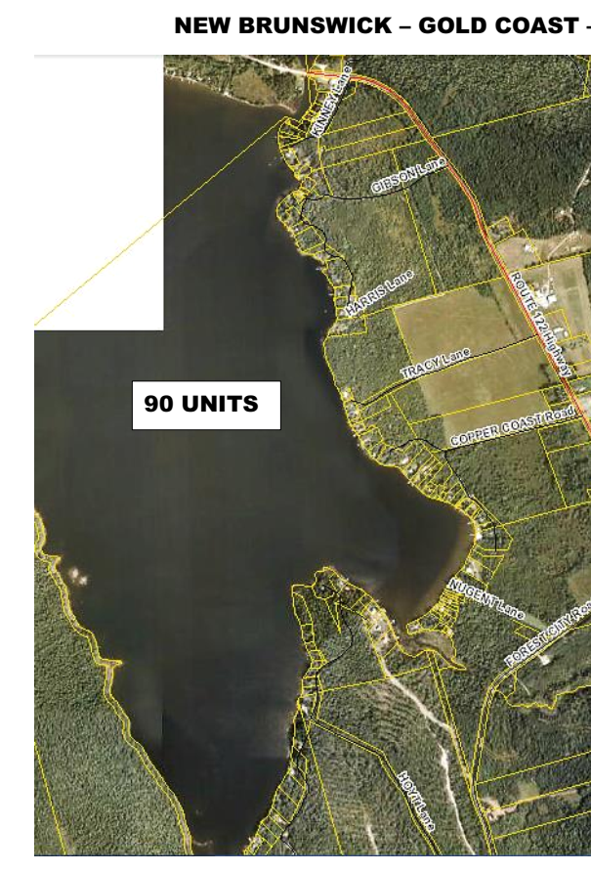
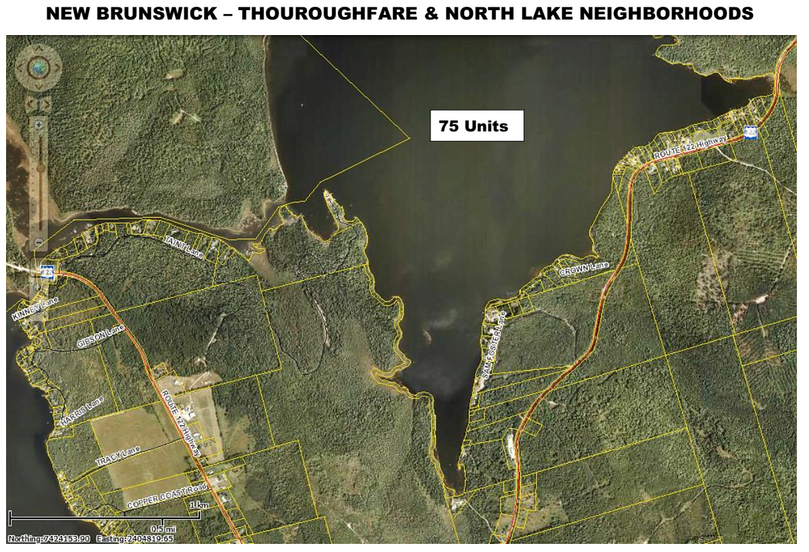
#9
NB LAKE NEIGHBORHOODS

Slide 27
#9
LAKE NEIGHBORHOODS
AN UNDERUTILIZED CUSTOMER BASE?
DRAFT SUMMARY
32 Lake Neighborhoods
156 – Year Round Units
1022 – Seasonal Units
1178 – Total Number of Units
Estimated Customer Base = 2,500

Slide 28
#10
DESTINATION GUIDE
Physical Place?
By Mail?
Digital?
“To receive the most current version of our Official Destination Guide via snail mail, fill out the form below.
Or, for the digital version, click on 2019 Destination Guide below.”

Slide 29
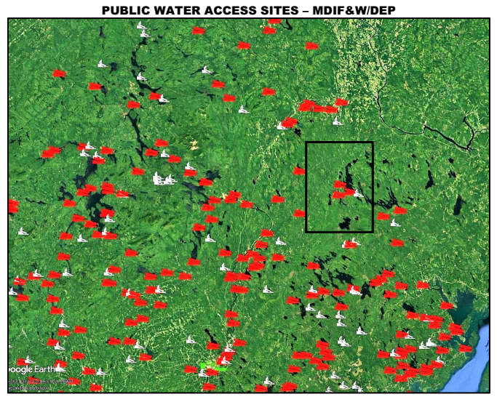
#10
SOURCE – DEP GOOGLE EARTH PUBLIC WATER ACCESS

Slide 30
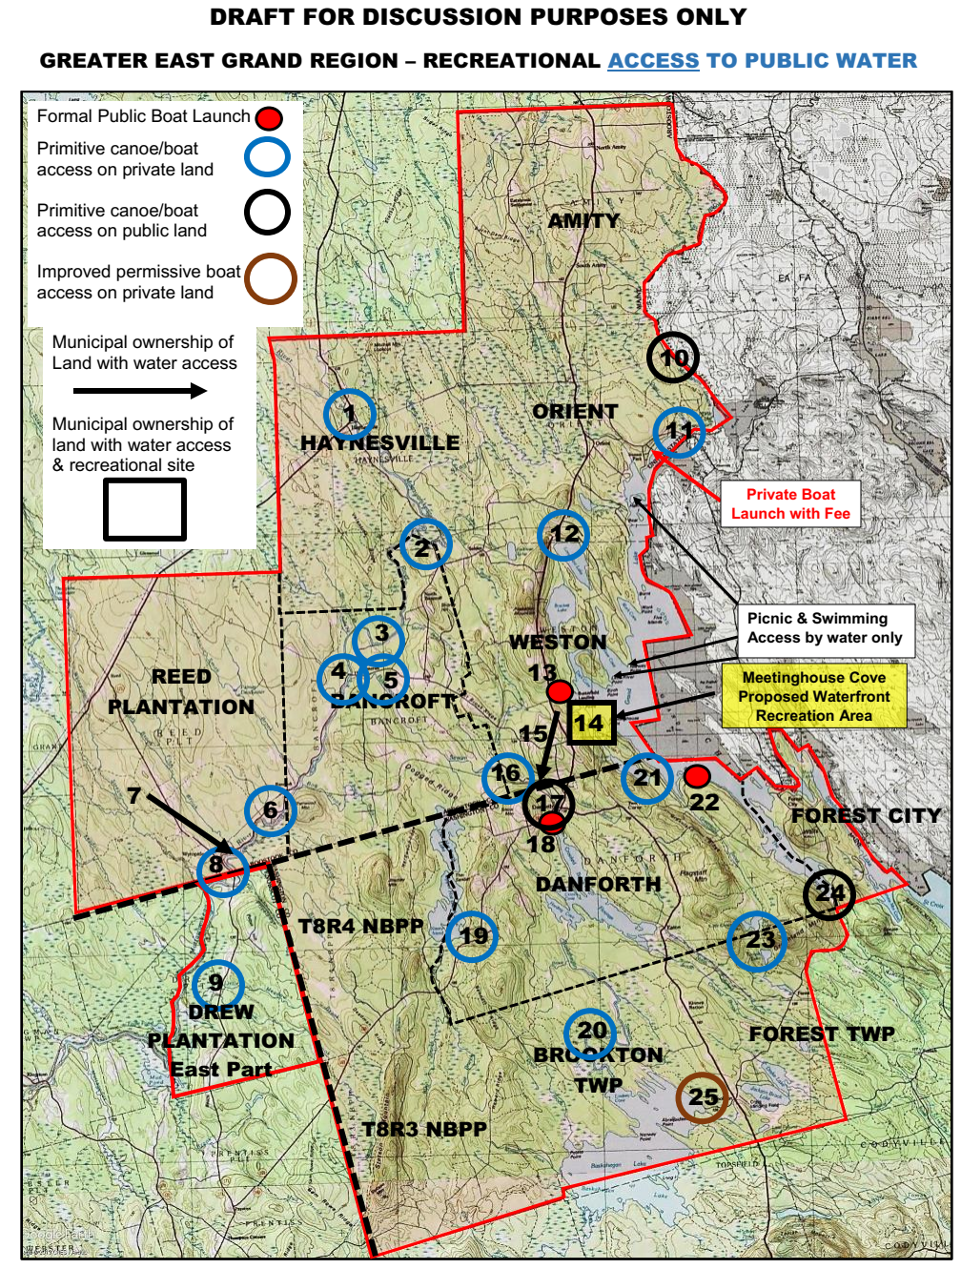
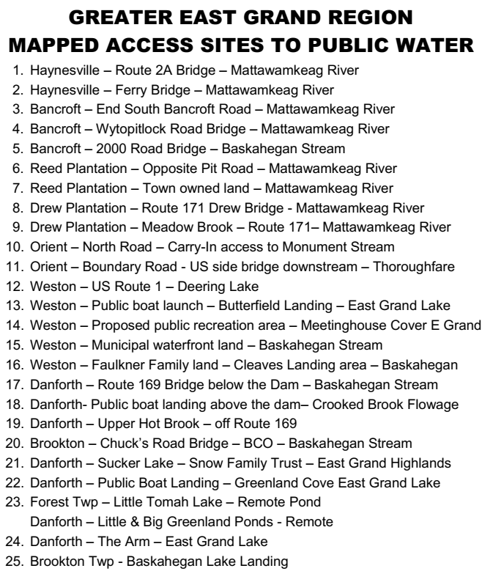
RECREATIONAL ACCESS TO PUBLIC WATER

Slide 31
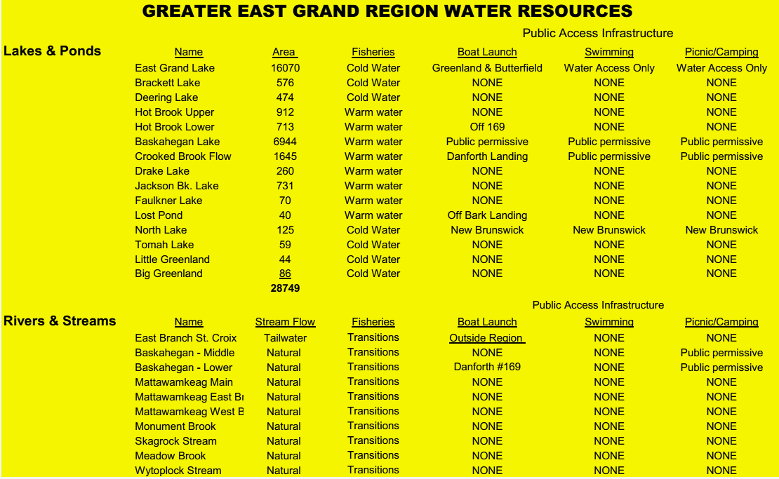
#10
DRAFT SUMMARY OF PUBLIC RECREATIONAL WATER RESOURCES
15 Lakes & Ponds
29,000 acres of water
3 public boat access sites
Public recreation areas - “Water Access Only”
7 Rivers & Streams
All natural flow
1 boat access site
No public recreation areas

Slide 32
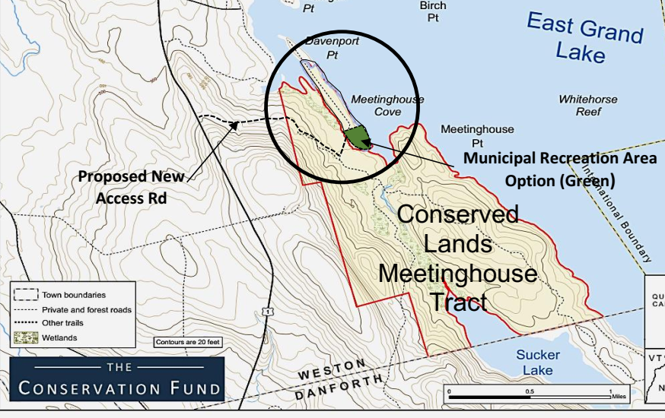
#10
FUTURE PUBLIC RECREATION AREA?

Slide 33
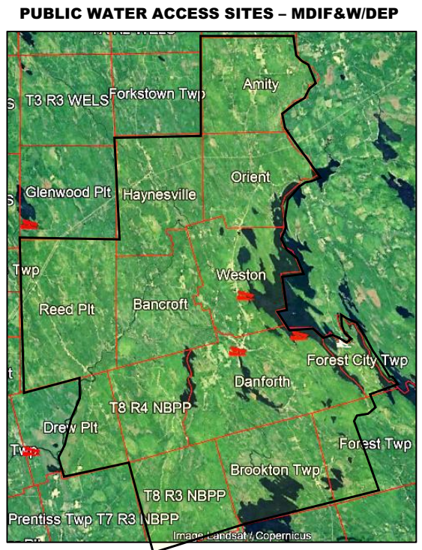
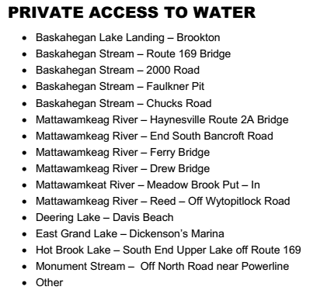
#10
GREATER EAST GRAND LAKE REGION
15 Key Locations on Private Lands!
Critical to preserve landowner permission!

Slide 34
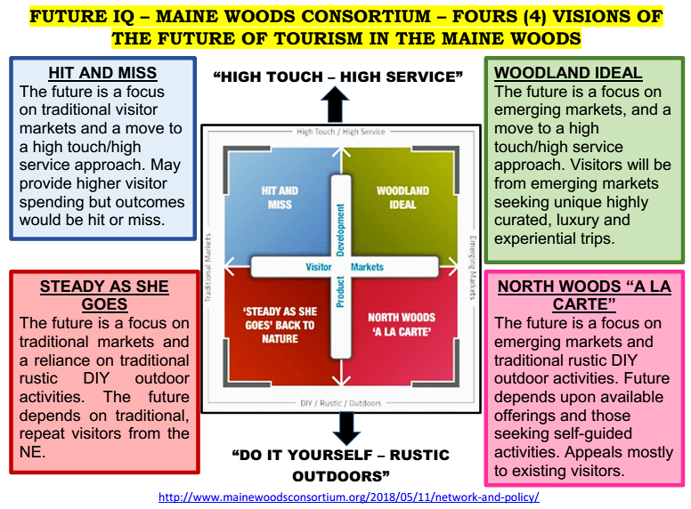
#10
DO ANY OF THESE DESCRIBE US?

Slide 35
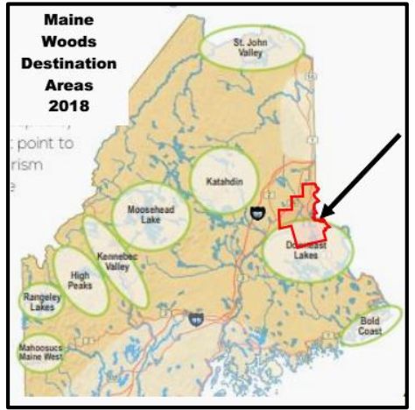
#10
HERE IS WHAT THE REPORT SAID! MAINE WOODS CONSORTIUM 2018
Key Points (Downeast Lakes) -
This area is the most remote and underdeveloped of any of the destination areas. Grand Lake Stream and Lakeville each have populations slightly over 100 residents.
Very limited lodging and visitor service capacity. Most visitors to the area are camping or bring their own lodging and services.
https://future-iq.com/project/maine-woods-usa-2018/
Includes Danforth
OPPORTUNITIES TO DEVELOP KEY CONNECTIONS?

Slide 36
#11
WORKFORCE DEVELOPMENT
Improving Access to Higher Education - Competitive Skills Scholarship: Provides workers with a grant to help them earn a degree or certificate in certain education or training programs.
Prior Learning Assessment: Allows students to obtain college credit for training and skills obtained outside the classroom.
On the Job Training / Apprenticeship - Allows workers to learn new skills through on-the-job training and related classroom instruction.
Pre-Apprenticeship: Includes two years of customized high school academics coupled with on-the-job training during the junior and senior years.
https://www.maine.gov/labor/workforce_dev/index.html

Slide 37
#12
LOWERING THE TAX BURDEN
Revenue
Increase taxable real estate thru growth
Aggressive response to the collection of receivables
Consider law enforcement revenues
Local sales & lodging taxes (Against the law in Maine)
Institute permit/use fees
Natural resource extraction fees
Seek grants and other non local taxpayer funding of projects/programs
Reduce Expenditures
Reduce and/or eliminate tax payer funded programs

Slide 38
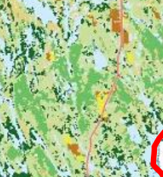
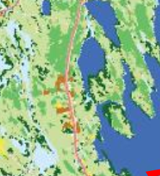
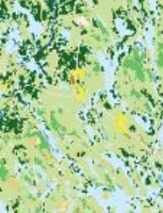
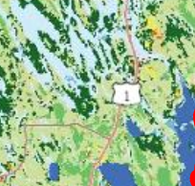
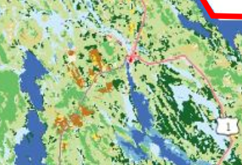
#13
Farmlands in Yellow & Brown
Weston
Amity
Bancroft
Orient
Danforth

Slide 39
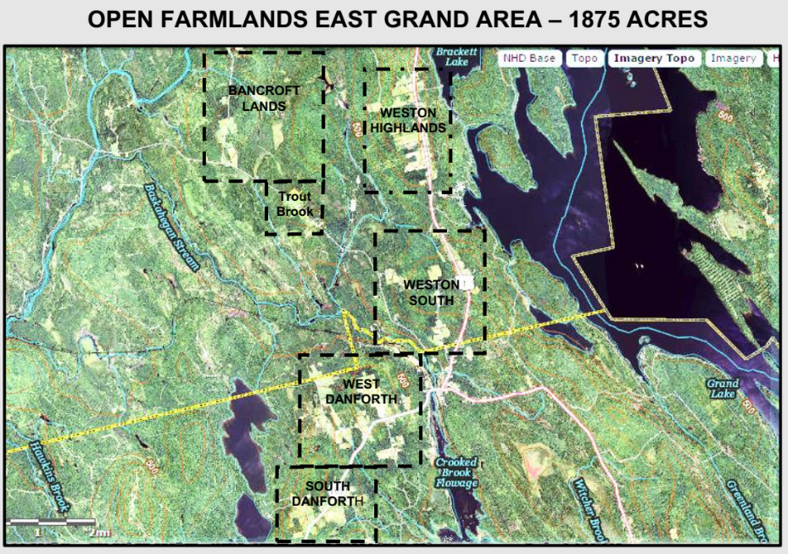
#13

Slide 40
#13
LOCAL AGRICULTURE
Local agriculture means short distribution channels involving no more than one intermediary between farm and consumer.
Locally grown food creates important economic opportunities such as farmers markets and health benefits.
The Maine Organic Farmers and Gardeners Association (MOFGA), formed in 1971, is the oldest and largest state organic organization in the country.
Community-supported agriculture (CSA) is a food production and distribution system that directly connects farmers and consumers

Slide 41
#14
SOME POTENTIAL FUNDING SOURCES
Maine Community Foundation
Elmina B. Sewall Foundation
The Quimby Foundation
Northern Border Commission
Northern Lands Council
Washington County Council of Governments
Sunrise County Economic Council (Washington County UT TIF Grants)
Northern Maine Development Commission
USDA Grants
State of Maine Development Office
Recreational Trails Fund
Land & Water Conservation Fund
Libra Foundation
Machias Savings Bank
Must have a compelling story
Understand funders goals and objectives and design funding requests accordingly
Do good marketing – get broad public support
Demonstrate need and desired outcomes
Have good grant writing and writers
Must have good fiduciary controls, accountability and a (5013C) non-profit organization
Have to have some “skin in the game” –In kind contributions a must
Seek a variety of funding sources including private philanthropy
Other

Slide 42
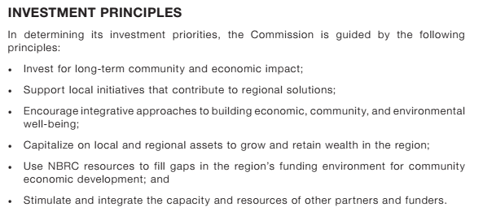
#14
EXAMPLE OF A FUNDING SOURCE

Slide 43
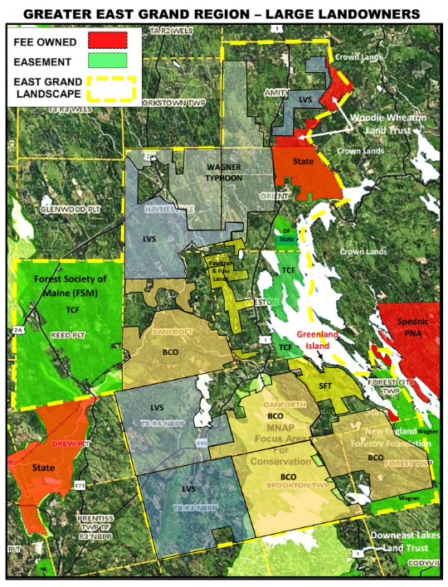
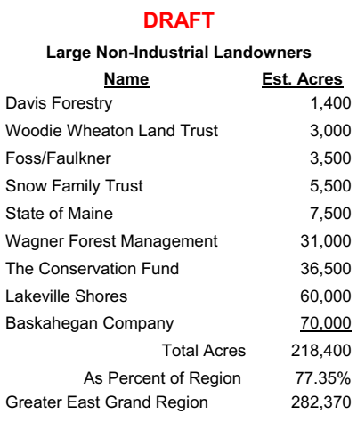
LAND & FOREST RESOURCES
#15
Are there any common sense solutions to the decline of the forest products economy at our local level?

Slide 44
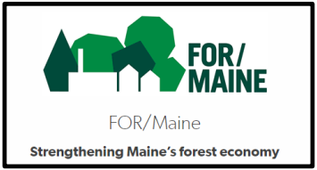
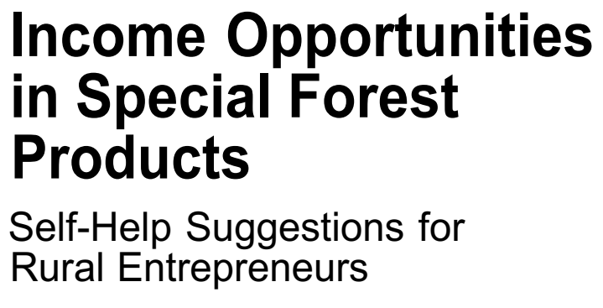
#15
INOVATIVE CONSUMTIVE USES OF OUR LOCAL FORESTS???

Slide 45
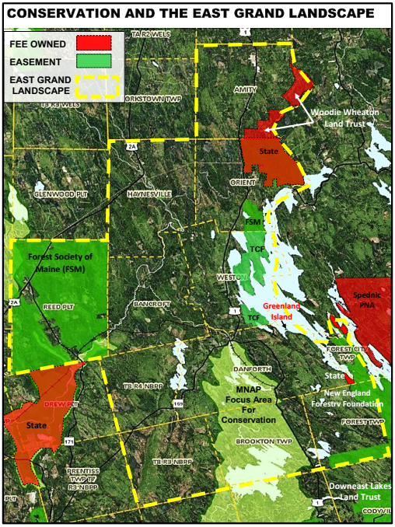
#16
CONSERVED LANDS
Conservation Acres
Fee 9,672
Easement 50,864
Subtotal 60,536
Focus Area 25,000
Grand Total 85,536

Slide 46
#16
THE ROLE OF CONSERVATION
Adds diversity in land use and goals
Preserve Working Forest
Encourage Sustainable Forest Management
Permanently guarantee public access
Ensure land is available for public recreation
Protect ecological, biological, cultural and scenic values
Attracts philanthropic capital to a region
A key component of economic development
http://mainefig.org/wp-content/uploads/2016/05/FIG_BiophysicalRegions_me_ecol_syst_ra_rept.pdf

Slide 47
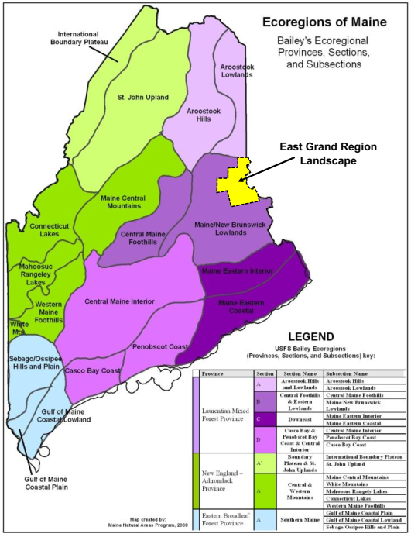
#16
The Maine-New Brunswick Lowlands Biophysical Region
is part of the Northeastern Mixed Forest Province and the Maine-New Brunswick Foothills and Lowlands Ecoregion Section.
There are 3 Forest Provinces, 6 Ecoregion Sections and 19 Biophysical Regions and 104 natural communities in Maine.
Eco-tourism: Capitalizing on the importance of the natural world (flora, fauna, local culture and heritage) to the economy of a managed landscape

Slide 48
#16
ECO-TOURISM NATURAL ASSETS
PUBLICALLY PROTECTED NATURAL AREAS
Monument Brook (State, WWLT, NB-PNA)
Orient Woods (State)
Monument Wetlands (WWLT)
Mattawamkeag River WMA (State)
Mud Lake Falls (State)
Booming Out Grounds WMA (State)
PRIVATELY PROTECTED NATURAL AREAS
Crooked Brook Flowage (BCO Lands)
Sucker Lake (SFT Lands)
Baskahegan Stream (BCO Lands)
Ecotourism Guide
Excellent communication skills
Being bilingual is an advantage
An expert on the environment & culture
Aware of international environment issues
Has good organization skills and abilities
Leadership qualities are a big plus.

Slide 49
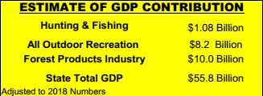
State of Maine
Sporting Camps & Lodges (Draft List)
Greenland Cove Camps
Cowger’s Lakeside Cabins
Rideout’s Lodge and Cottages
Wheaton’s Lodge
Village Camps
Wilderness Escape Outfitters
Birchwood Cottages
East Branch Lodge
First Settler’s Lodge
Birch Hill Camps
Paradise Cabins
Hunting & Fishing 4,100 Jobs
All Outdoor Recreation 7,400 Jobs
Forest Products Industry 14,500 Jobs

Slide 50
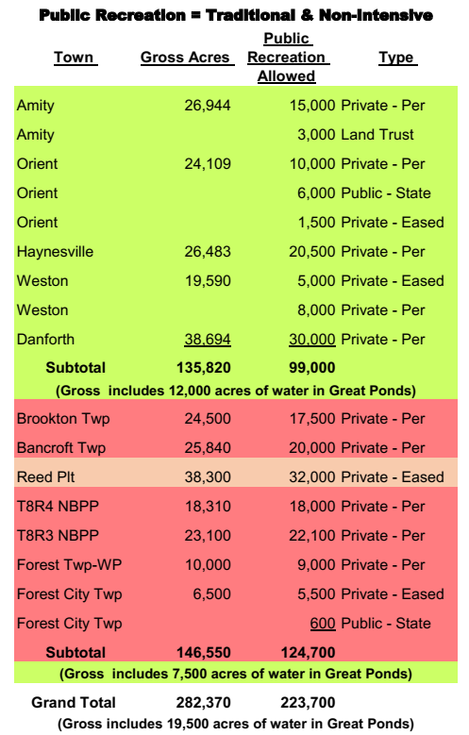
MAINE LANDOWNER LIABILITY LAW
#18
Under Title 14, Section 159-A of the Maine Revised Statutes, a landowner does not have a duty of care to keep a premises safe for entry or use by others for recreational or harvesting activities or to give a warning of any hazardous condition on the premises to anyone entering for those purposes.
The Gold Standard in Preserving Maine’s Outdoor Heritage
Over 80 % of the Region is open free of charge to traditional public recreation.
http://www.rudmanwinchell.com/maine-s-landowner-liability-law/

Slide 51
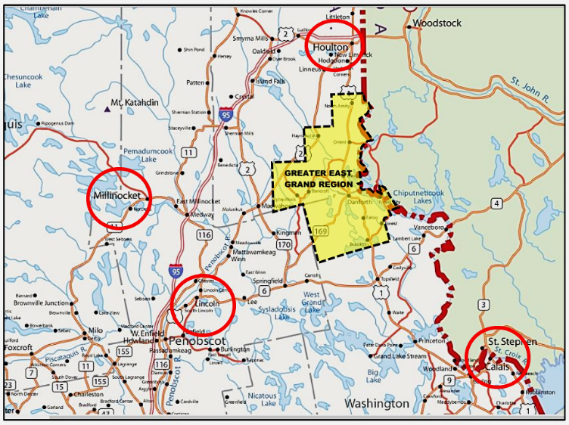
#19
ASSETS OUTSIDE OF GREATER EAST GRAND LAKE REGION

Slide 52
#20
CREATING A VISION
GREATER EAST GRAND REGION ECONOMIC PLAN
DRAFT CONCEPT OF A
VIDEO & NARRATIVE PRODUCTION OF
“A HERITAGE RECLAIMED”
“A Heritage Reclaimed” is about bringing renewed purpose and a true sense of place to a rural way of life and to the communities on which those lives depend.

Slide 53
BUILDING AN AGENDA FOR THE MAY 22ND MEETING
Develop Strategic Plan
Assess Volunteer Capacity
Determine Need for Consultant
Secure Funding for Planning Phase
SWOT Analysis
Capitalize on existing momentum
Asset Mapping Process
Gap Analysis
Reporting & GIS Map Applications

Slide 54
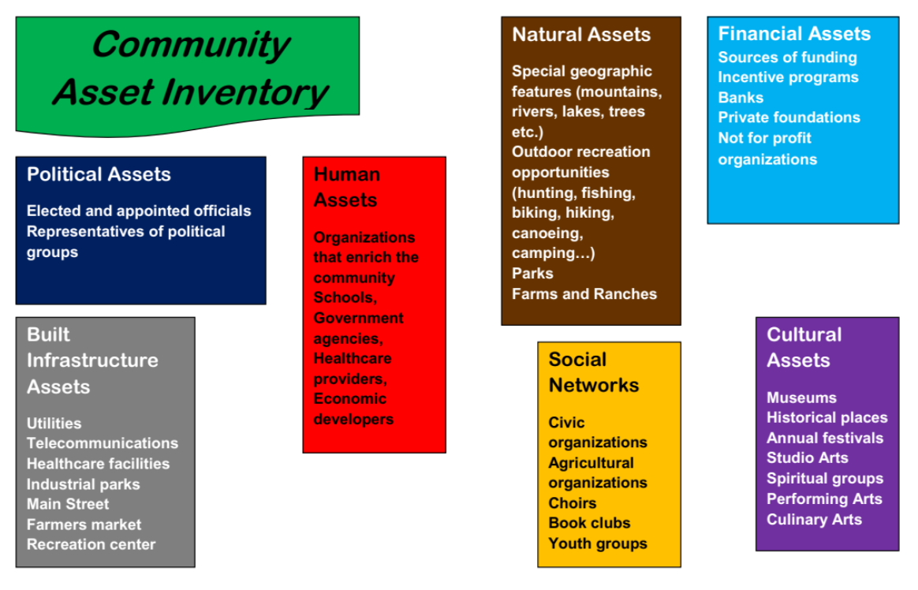
ASSET BASED COMMUNITY DEVELOPMENT

Slide 55
THE PROCESS OF PLANNING
A Look at Greenville
https://future-iq.com/project/moosehead-lake-region-maine-usa-2016-17/

