Slide 1
Greater East Grand Region Economic Plan “A Heritage Reclaimed”
Planning Update & A Look Ahead December 4, 2019
On behalf of GEGREP Steering Committee Members, associated Towns and Organizations; Initial Planning Team; Sarah Strickland; Sunrise County Economic Council; Northern Maine Development Commission; Washington County Board of Commissioners; Individual and Corporate Donors; and the
Southern Aroostook Development Corporation.

Slide 2
Three Major Objectives
1) Establish a credible economic voice for the Region.
2) Identify, thru citizen input, community and regional assets that have economic potential.
3) Develop specific recommendations on how those assets and relationships can be used to foster economic growth.

Slide 3
Guiding Principles
Economic Development is a process for creating wealth from which many community benefits are derived. It occurs in the private sector.
Community Development is a process of making the community a better place to live and work and occurs primarily in the public sector.
Planning is not development.
Planning sets the table for development.
Economic and community development are interdependent and reinforce each other.
Planning is not development.
Planning sets the table for economic and community development.

Slide 4
Why a Regional Economic Approach?
Regional economic development capitalizes upon the strengths of specific rural communities/areas.
Helps applicants overcome jurisdictional challenges - leverages public and private funding.
Regional projects have a larger impact, enabling greater wealth creation and quality of life improvements.
LUPC BASE MAP

Slide 5
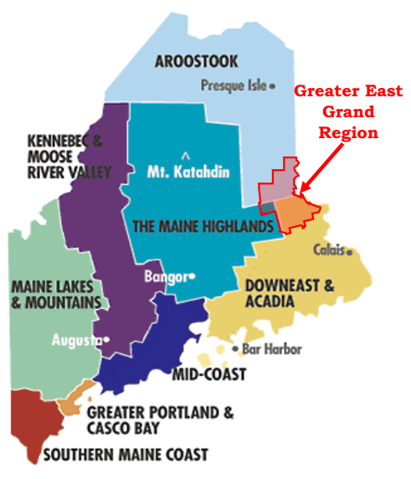
Overcoming Barriers to Area Identification Who Are We? Where Are We? What Sets Us Apart?

Slide 6
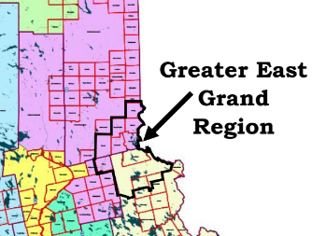
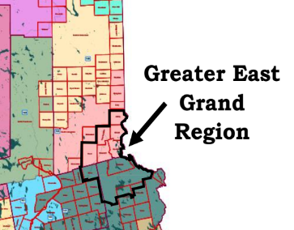
Overcoming Barriers to Area Identification Who Are We? Where Are We? What Sets Us Apart?
Senate Districts
House Districts

Slide 7
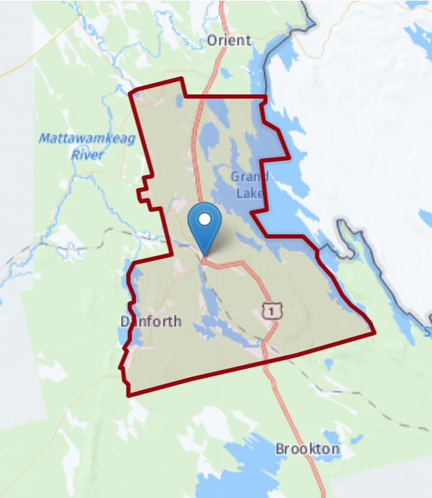
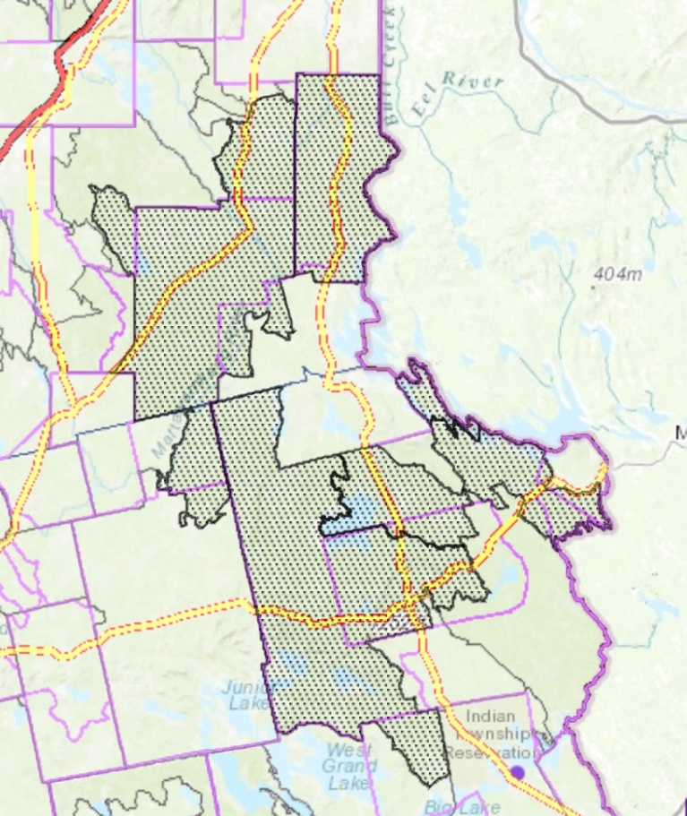
Overcoming Barriers to Area Identification Who Are We? Where Are We? What Sets Us Apart?
School District
Health Center Service Area

Slide 8
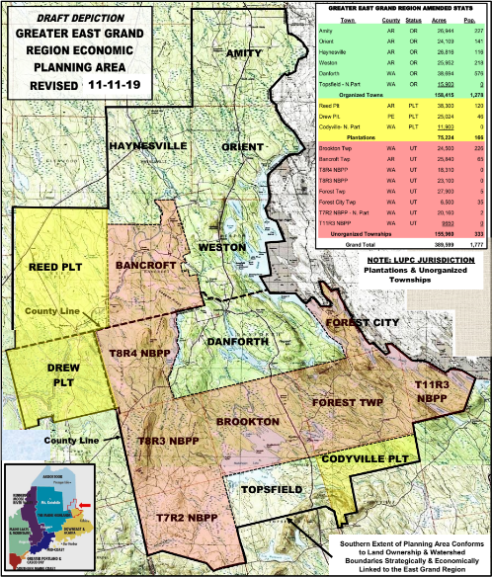
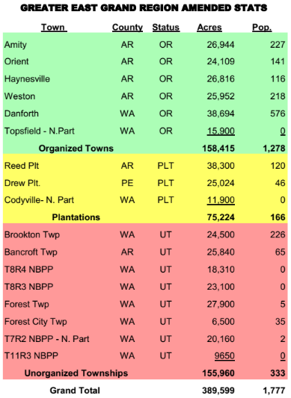
Zoning & Planning Jurisdictions

Slide 9
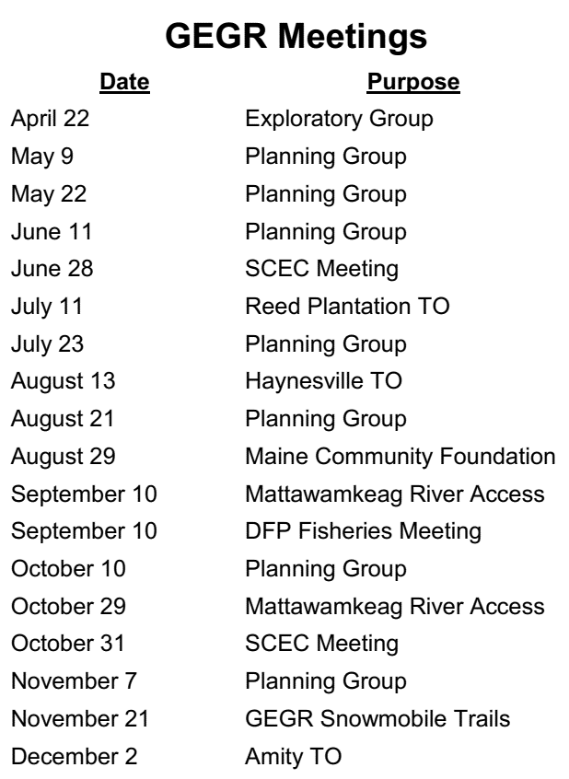
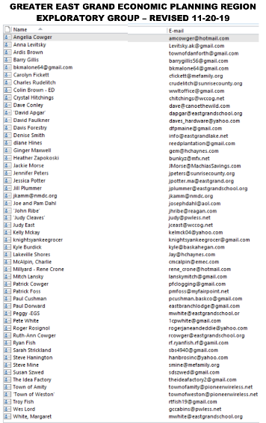
People First - Getting Established

Slide 10
Getting Started
April - July
Group consensus to proceed
Citizen driven asset-based mapping approach chosen
Research on economic issues and planning in rural Maine/US
Developed and revised map of the Planning Area/Region
Began draft mapping (Google Earth) and data mining: access to public water, land ownership, recreational trails (water-hiking-motorized), natural features and resources, broadband service, location and acreage of farmlands, lake neighborhoods, rural residential areas, planning jurisdictions and barriers , etc.
Drafted a compelling narrative for funders
Developed a working set of goals & objectives
Conducted preliminary SWOT analysis – identified major threats: loss of FC dam & closure of school
Assembled project outline, initial budget and deliverables

Slide 11
Project Fund Raising
Total budget = $45,000: $30,000 cash; $15,000 in-kind
Secured
$15,000 in-kind contributions – SCEC, NMDC, CORE
$10,000 from WC TIFF grant
$8,500 from private and corporate fund raising
Pending
$10,000 Innovation Grant from MCF.
Obtained SCEC approval for Project Director to contract the work through SCEC.

Slide 12
Relationship Building
Introductory selectperson meetings – Reed, Haynesville, Amity, Orient
Initiated contacts with IF&W & BPL about water access
Met with IF&W at Mattawamkeag River - Drew, Reed and Haynesville - coordinated plan with BPL (Sue Szwed)
Engaged in Forest City Dam – CLIC Rally, press release, interviews and offered FERC testimony in Danforth
Chaired fisheries meeting with DFP at Rideouts
Drafted maps of area bike trails for Jay Kamm at NMDC
Began planning heritage and canoe launch project below Beans Falls in Bancroft (LUPC Zoning implications)

Slide 13
Official Project Launch
November 1st Press Release state-wide
Revised process of asset identification and area meetings
Obtained promise of advice from the Southern Aroostook Development Corporation – focus on economic development
Began assembly of GIS digital data - UM Machias (No charge)
Began asset mapping database
Held an organizational meeting with 4 area snowmobile clubs - will hold similar meeting with 3 ATV Clubs later this winter

Slide 14
Project Timeline
December – February
Hold area meetings - select persons, citizens, and area organizations
Complete Asset Mapping data collection and GIS base mapping with UMM
Explore state-wide initiatives to help implementation
Build upon existing relationships with State and regional agencies
Identify potential economic development projects for every jurisdiction
Assemble info on on-going community development projects
Draft preliminary assessment and emerging recommendations for discussions with stakeholders.

Slide 15
Project Timeline
February - April
Meet with business development group from SADC, SCEC, local entrepreneurs, etc
Hold community meetings to review assessment and gather recommendations
Complete next draft of feasibility plan and review with Steering and Planning committees
April – May
Finalize plan
Communicate plan and priorities to communities and seasonal residents
Initiate search for local Economic Development Coordinator for region

Slide 16
Greater East Grand Region Economic Plan “A Heritage Reclaimed”
Questions
Discussion
Recommendations
Availability

