Slide 1
Lakes & Lake Neighborhoods in the
Greater East Grand Lake
Region of Eastern Maine

Slide 2
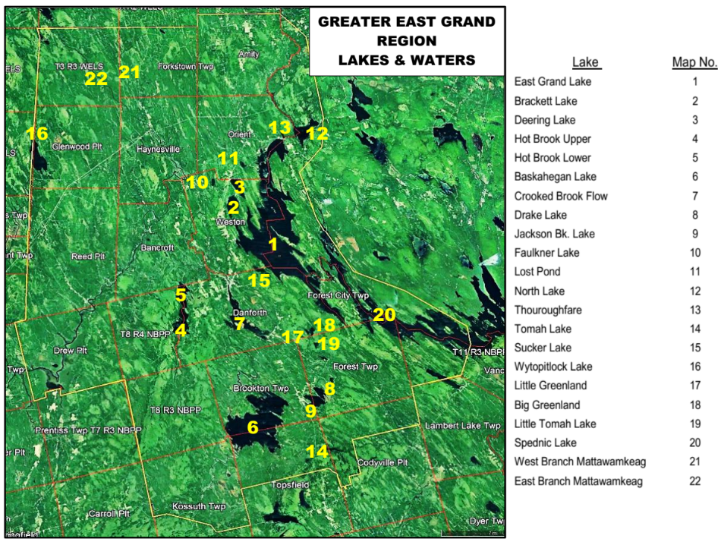

Slide 3
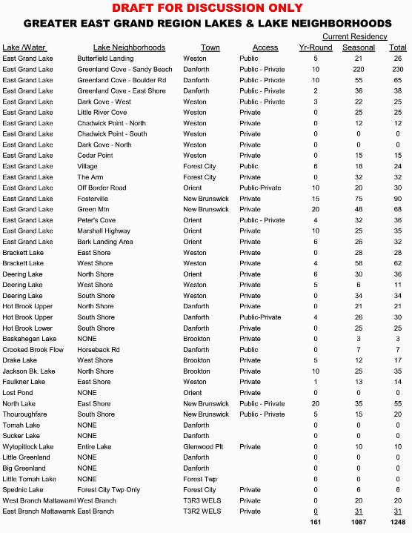
LIST OF LAKE NEIGHBORHOODS BY LAKE

Slide 4
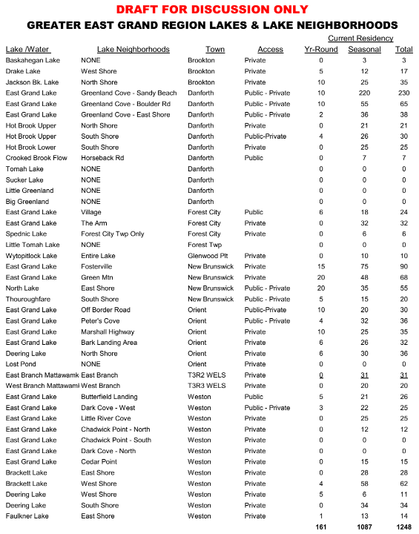
LIST OF LAKE NEIGHBORHOODS BY TOWN

Slide 5
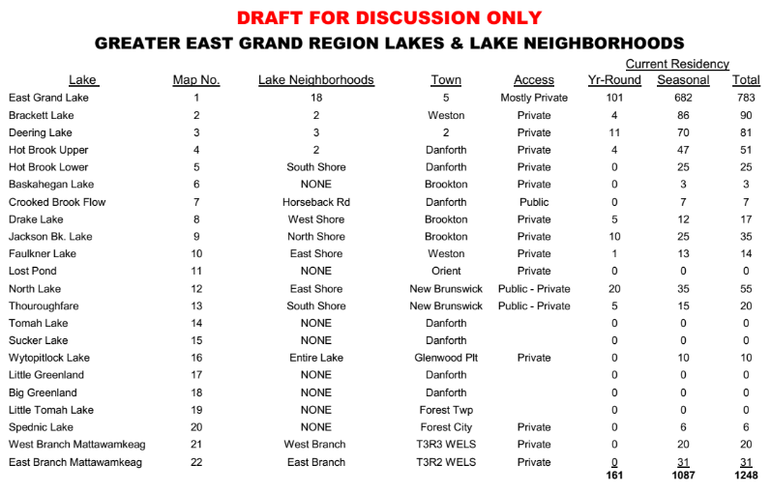
SUMMARY OF RESIDENCY OF LAKE NEIGHBORHOODS BY LAKE

Slide 6
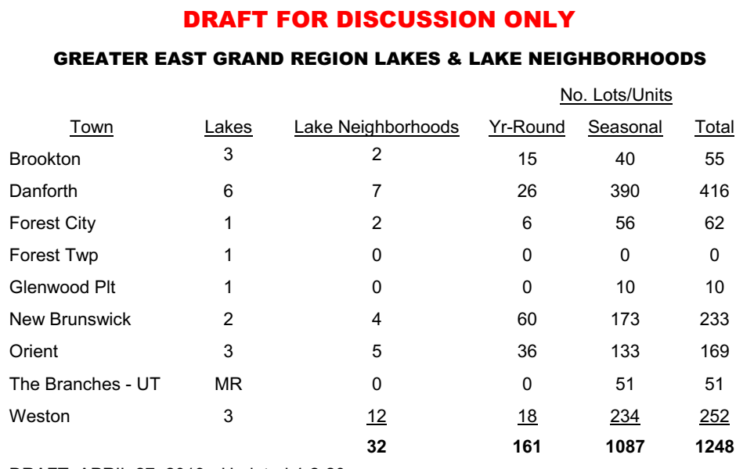
SUMMARY OF RESIDENCY OF BY TOWN/PROVINCE

Slide 7
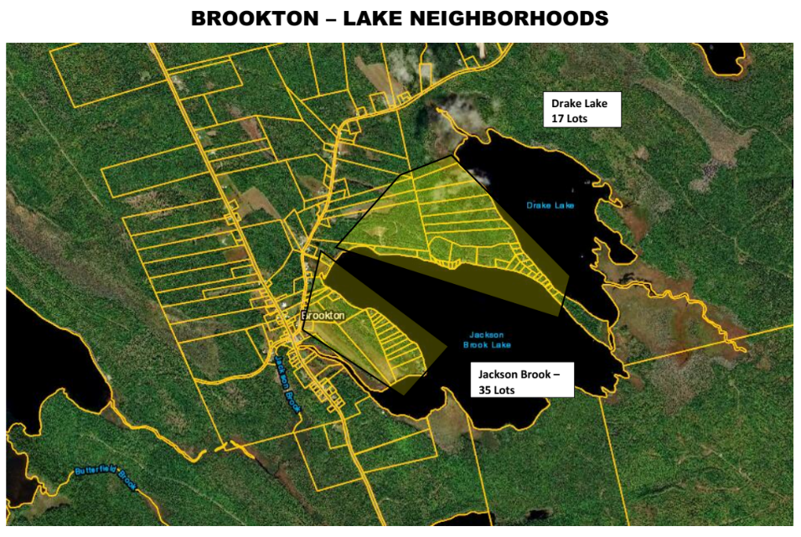

Slide 8
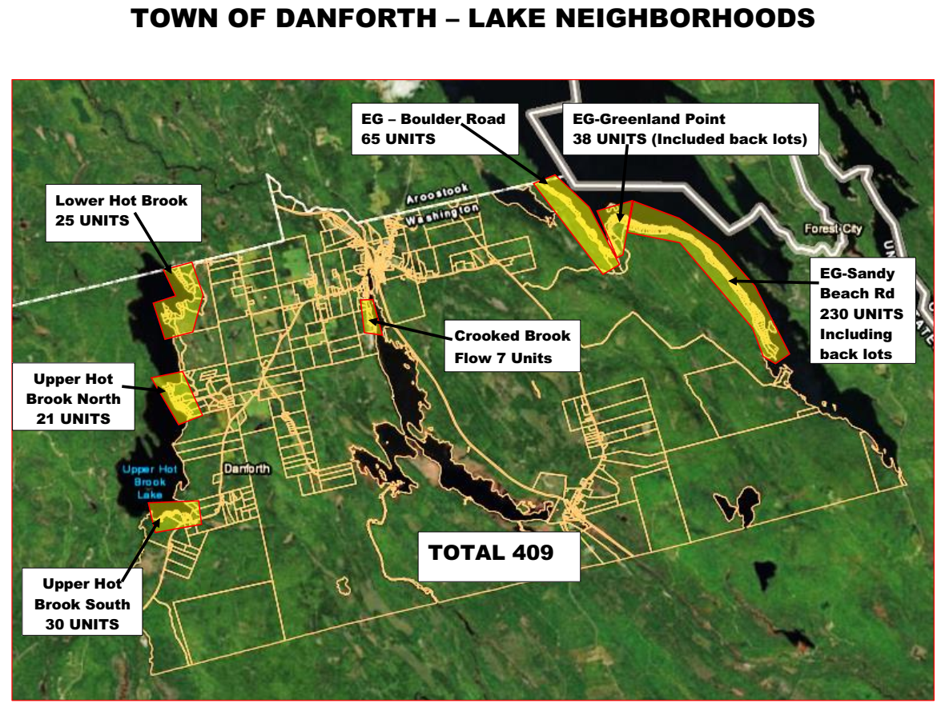

Slide 9
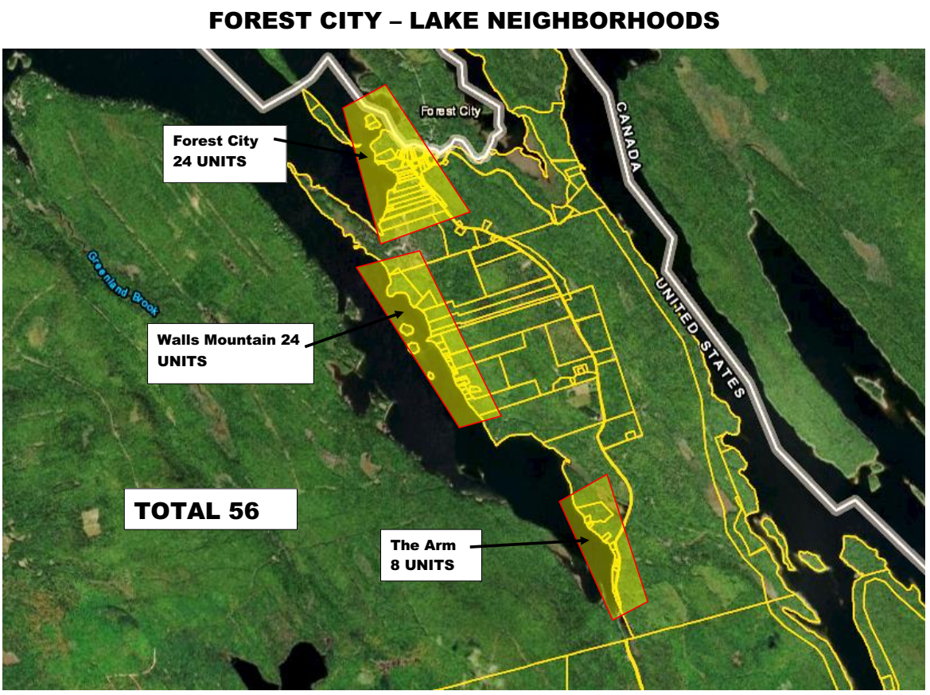

Slide 10
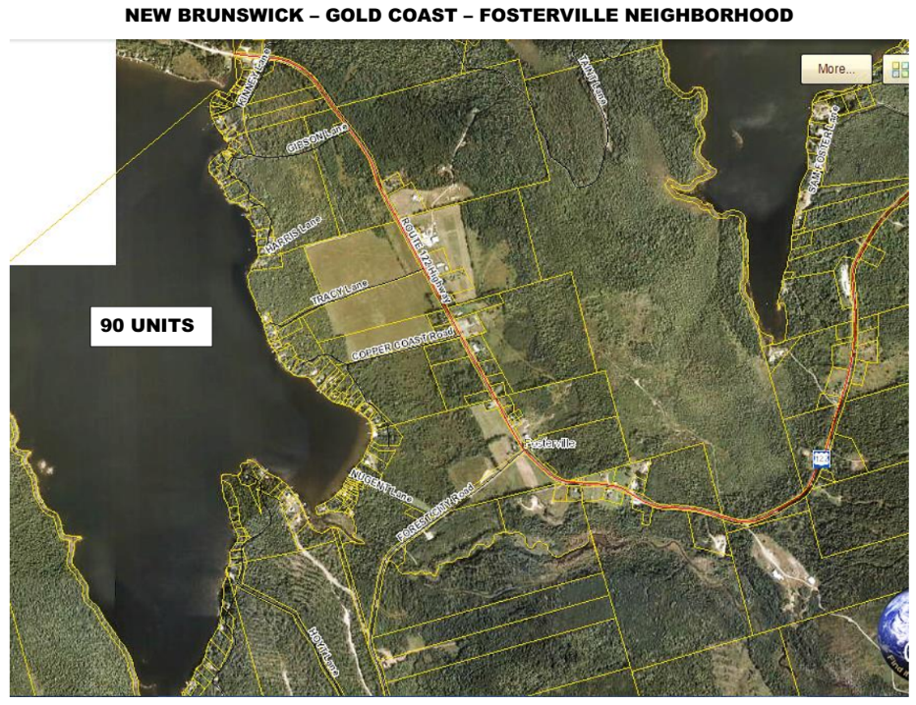

Slide 11
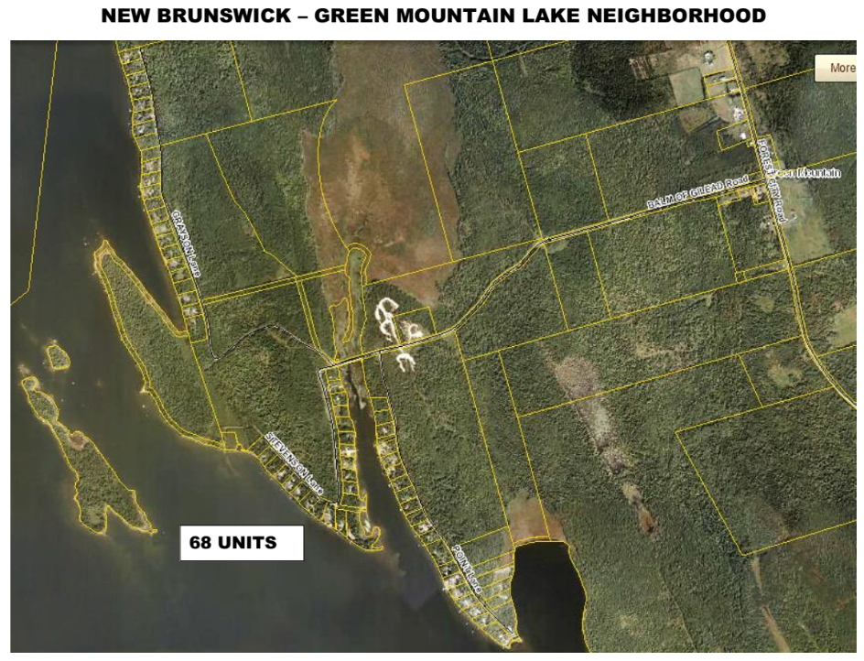

Slide 12
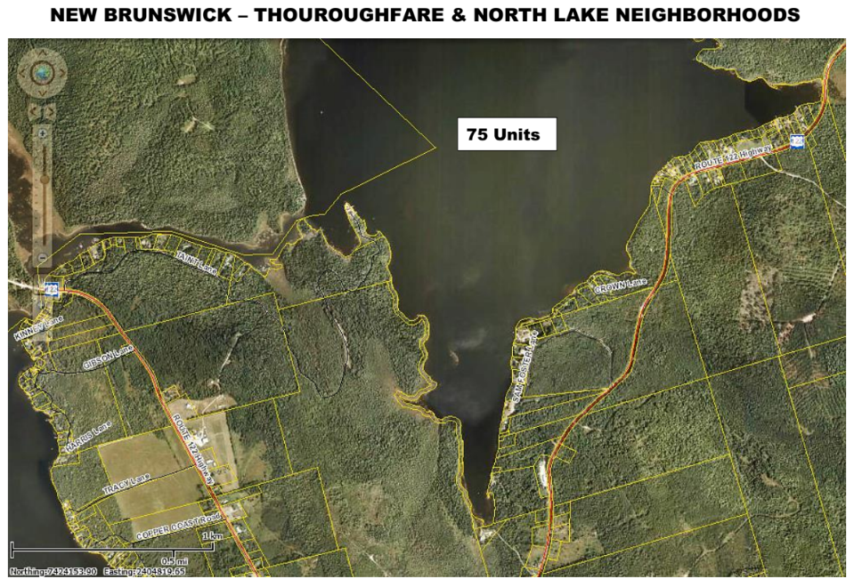

Slide 13
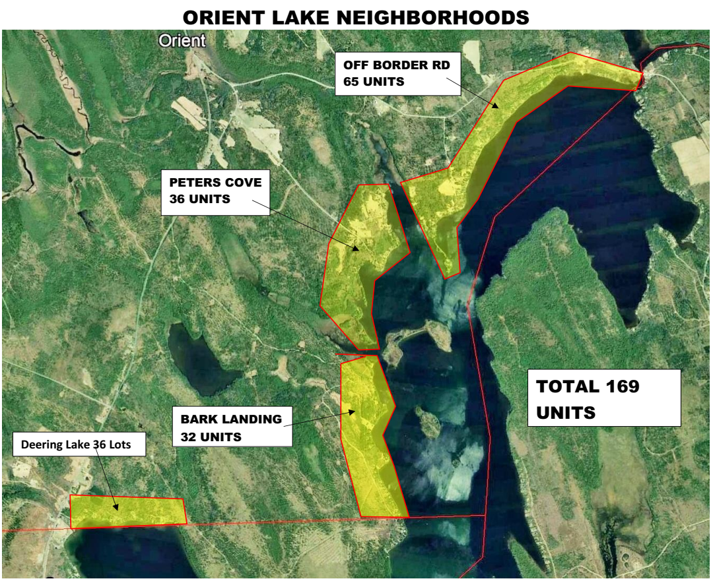

Slide 14
