Slide 1
Envisioning the Future of the Greater East Grand Region
The Long View
A Model for Consideration?
DRAFT DATED: March 18, 2019

Slide 2
THE FUTURE OF THE GREATER EAST GRAND REGION
Based on many interviews and conversations over the past few months the evidence is clear…
Our most pressing and overriding economic issue: the lack of youth! as workers, entrepreneurs and engaged citizens helping to sustain a rural quality of life.

Slide 3
THE FUTURE OF THE GREATER EAST GRAND REGION
“Research shows 37% of millennials want to live in cities, 36% in suburbs and 26% in small towns or rural areas. Included in the 26% are those that leave and wish to move back – but small towns must do some work to recruit and retain them.” (There are great examples of youth from our area who fall into this category)
See strategies to attract and retain young residents by Schroeder, Director of Youth Engagement at the Center for Rural Entrepreneurship in Lincoln, Nebraska.
Next Slide

Slide 4
THE FUTURE OF THE GREATER EAST GRAND REGION
Strategies to attract and retain young residents:
High-speed internet is a basic state of modern life, it enables long distance learning and online business.
Invest in youth priorities. Millennials value socialization so it’s important for rural communities to create “third spaces”
Provide entrepreneurial opportunities. More than 70 % of young people want to own a business, 17% already do.
Actively engage and consult youth. Make sure they know their ideas and opinions matter. Involve them in community planning and local government.
Market your community to attract young people. Campaigns targeting young people in short, digital formats. Promote small-business friendliness and peer-to-peer recommendations.

Slide 5
THE FUTURE OF THE GREATER EAST GRAND REGION
So, the following question was posed to sources familiar with ongoing efforts elsewhere.
Are there examples of other people/rural places in the nation who have tried to tackle the problem OF THE LACK OF YOUTH?
Goal: To have a short and long-term recommendation/vision at the very top of our economic planning efforts.

Slide 6
THE FUTURE OF THE GREATER EAST GRAND REGION
ONE OF THE RESPONSES: “We've spent time building resources and our community partners have taken many creative approaches to engaging youth in all types of programs and projects. Overall, not something that can happen overnight, and takes quite of bit of intentional focus and time to develop.”
“Engaging youth happens along a spectrum of programs and projects. Approaching youth, like any partnership, takes asking what is inspiring and engaging to them - going directly to youth can be very enlightening. Going directly to schools, community centers, etc.”
Here's a couple of examples:

Slide 7
THE FUTURE OF THE GREATER EAST GRAND REGION
Example #1
Generation West Virginia (http://generationwv.org/) is an outstanding youth empowerment non-profit connecting the dots between job skill development, service, and youth retention. They did a really interesting survey of young voters to understand what will keep them working in West Virginia.

Slide 8
THE FUTURE OF THE GREATER EAST GRAND REGION
Example #2
PA Wilds Center for Entrepreneurism has set up a great "in-classroom" learning series about the PA Wilds as a place to start a business and how to do that and went to all the high schools across the PA Wilds. They even created awesome maps for the kids to put up in their lockers or at home, even when away at college for them to remember how great their home is.

Slide 9
THE FUTURE OF THE GREATER EAST GRAND REGION
A Closer Look at PA Wilds
PA Wilds, founded in 2004, is a non-profit, branded, economic development and marketing entity with a footprint of 2 million acres in rural north central PA. Once an area of much logging and oil production, it’s communities have seen years of decline and poverty. PA Wilds, is heavily funded by philanthropic, public dollars, grants and fees. It is multi-faceted with a much different land and population base, but the parts of their work on entrepreneurism and marketing is potentially where we may learn the most. https://pawilds.com/

Slide 10
THE FUTURE OF THE GREATER EAST GRAND REGION
What can we learn from PA WILDS?
The Landscape is comprised of a mosaic of distinct areas of commonality of assets
Communities are recognized within each distinct area
Marketing, branding, business development and entrepreneurship is enhanced thru the combined power of the uniqueness of each area
The Region is united by a common vision, set of goals and purposes
See Depictions of PA Wilds Landscape – Next 4 Slides

Slide 11
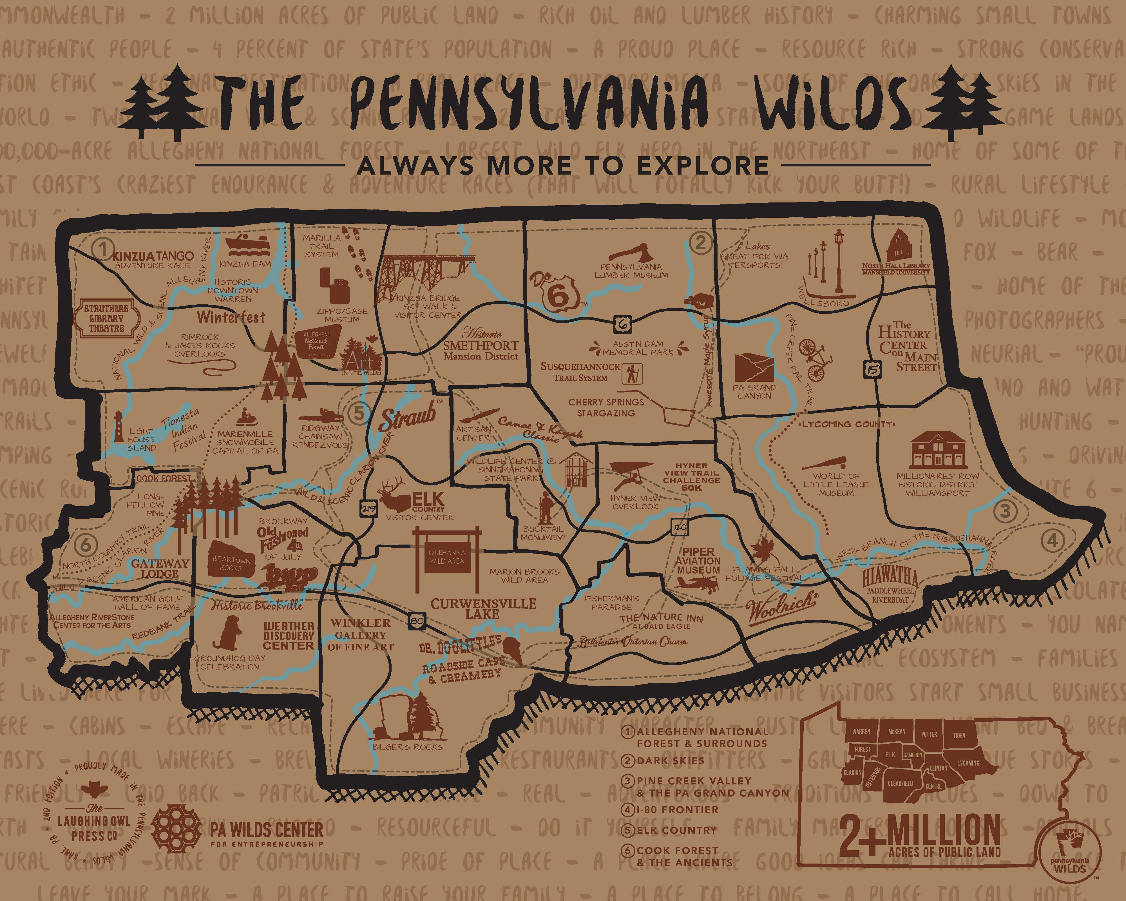

Slide 12
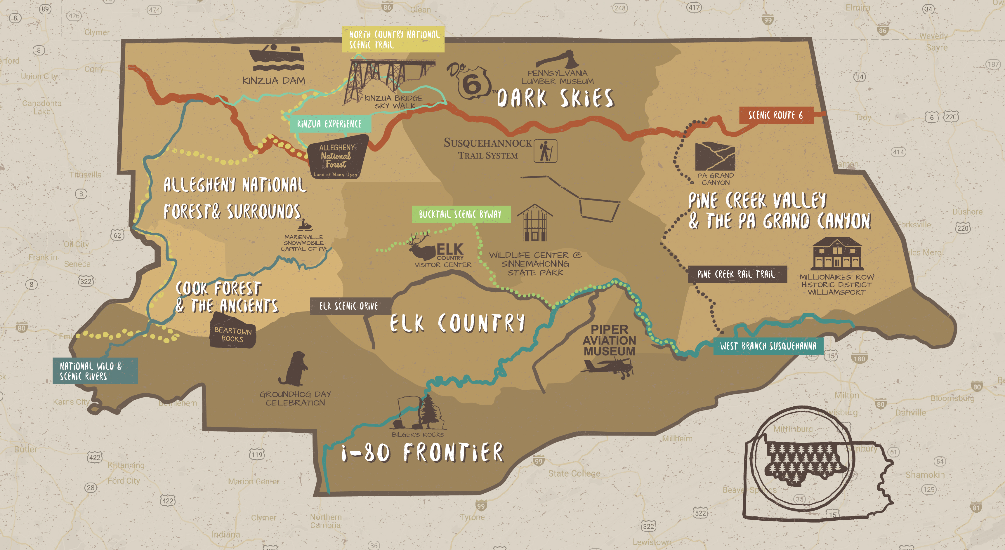

Slide 13
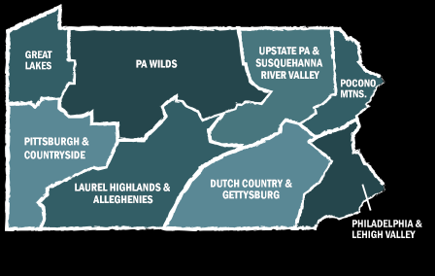

Slide 14
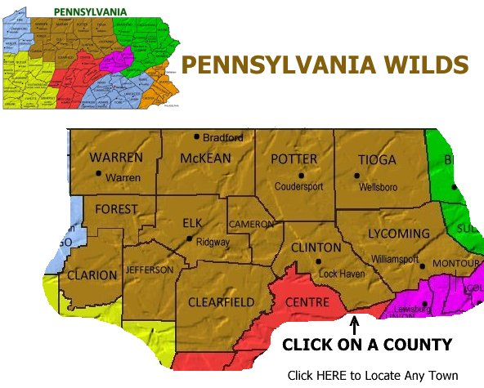

Slide 15
THE FUTURE OF THE GREATER EAST GRAND REGION
How would we envision applying some of the thinking about the organization of the landscape of PA Wilds to our Region of Maine?
In other words the Wilds landscape was not divided along political or municipal boundaries, but it was enlarged and organized according to the geographic locations of shared assets and themes.
SEE NEXT SLIDE

Slide 16
THE FUTURE OF THE GREATER EAST GRAND REGION

Slide 17
1) Expand GEGR To be more Inclusive of Planning Area & Directly Adjacent Assets
Add 70,000 acres in the northwest and 50,000 acres in the balance of the Upper St. Croix River Watershed.
Adds 3 residents for Glenwood - all else in T3R3, T3R2 are seasonal camp owners
Adds southern portions of the East and West Branch watersheds and approximately 4 adjoining landowners
Adds the very small NB communities of Fosterville, Green Mountain, Pemberton Ridge and Forest City NB as well as cottage owners on the Canadian shore of East Grand and North Lakes.
Makes GEGR International and over a Half Million Acres in size - SEE NEXT 3 SLIDES

Slide 18
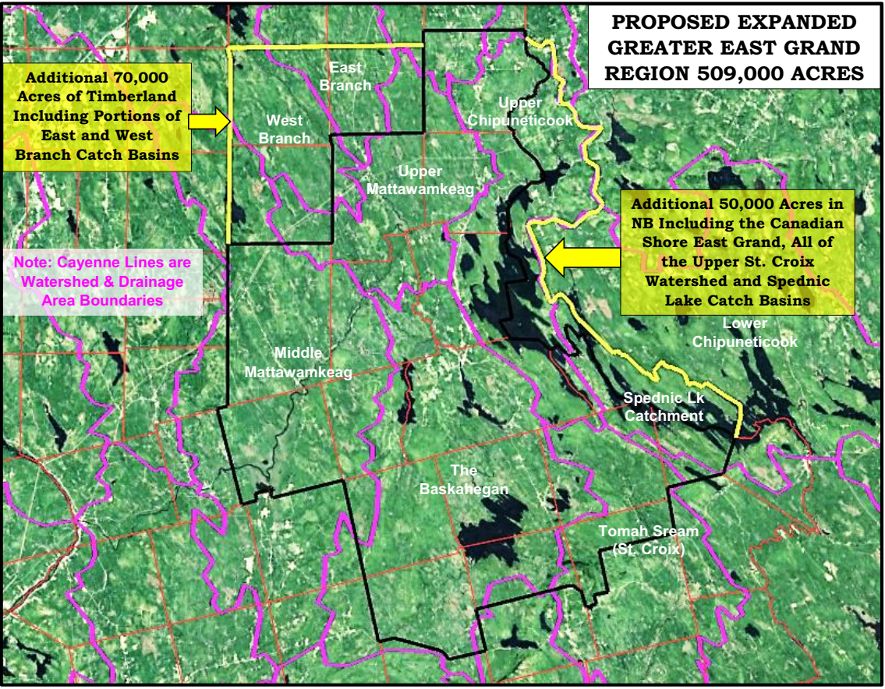

Slide 19
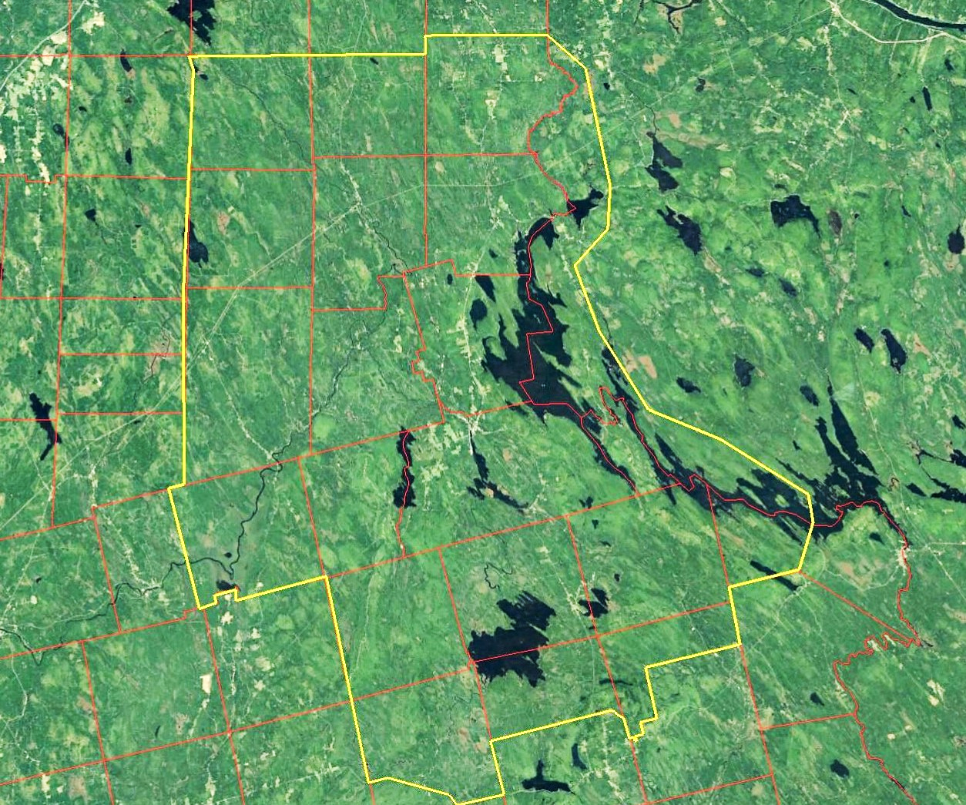
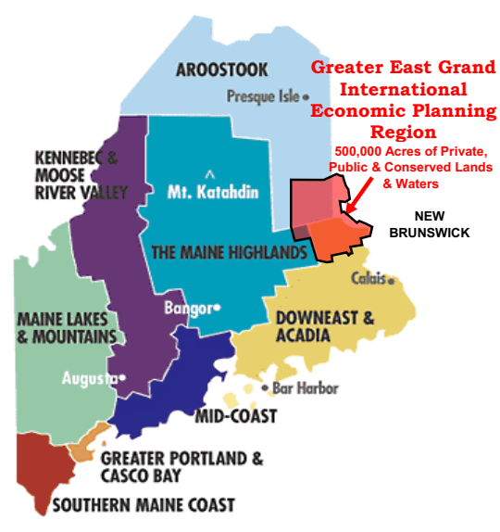
PROPOSED EXPANDED INTERNATIONAL GREATER EAST GRAND ECONOMIC PLANNING REGION
Geographic Area = 509,000 Acres +/-

Slide 20
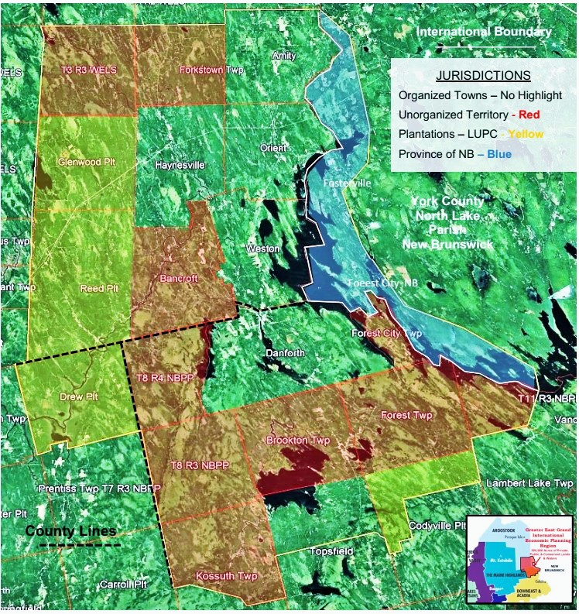
PROPOSED EXPANDED INTERNATIONAL GREATER EAST GRAND ECONOMIC PLANNING REGION
Geographic Area = 509,000 Acres +/-

Slide 21
2) Define and outline geographic areas of commonality within the Region
SEE DEPICTIONS ON NEXT SERIES OF SLIDES

Slide 22
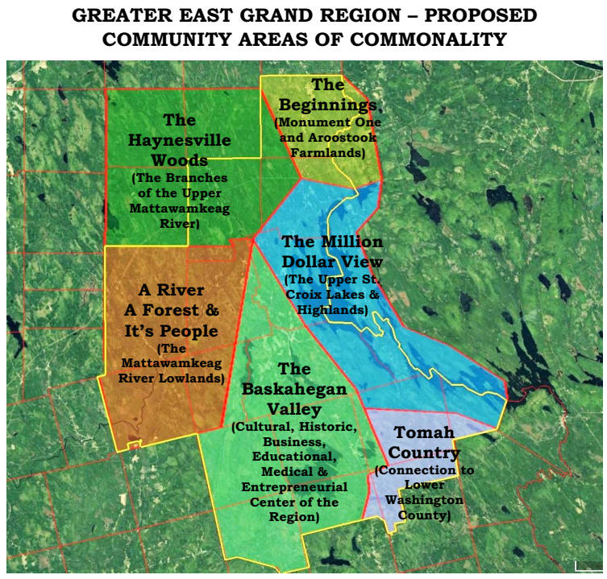

Slide 23
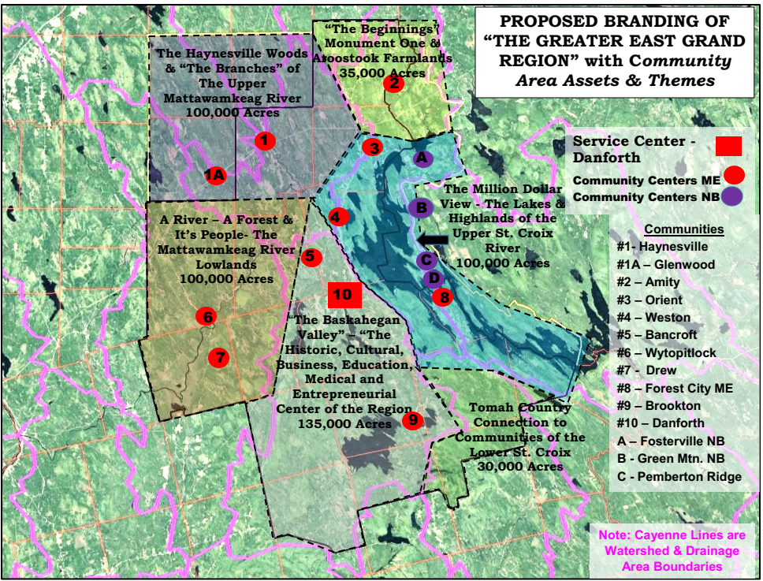

Slide 24
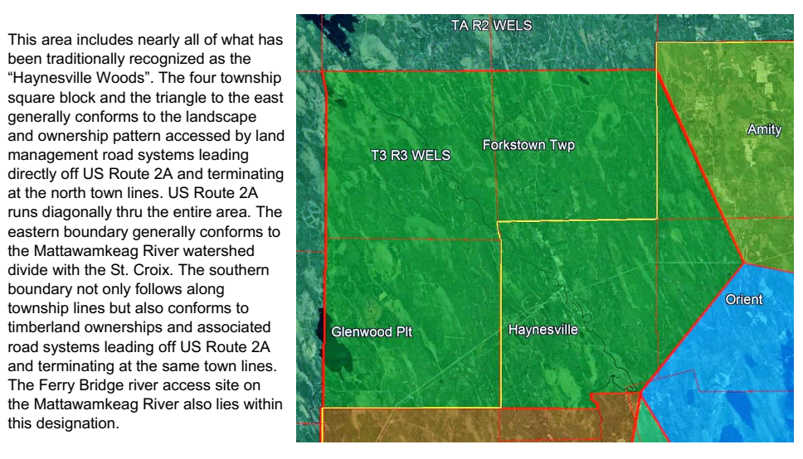
THE HAYNESVILLE WOODS – 100,000 ACRES
The Branches of the Upper Mattawamkeag River

Slide 25
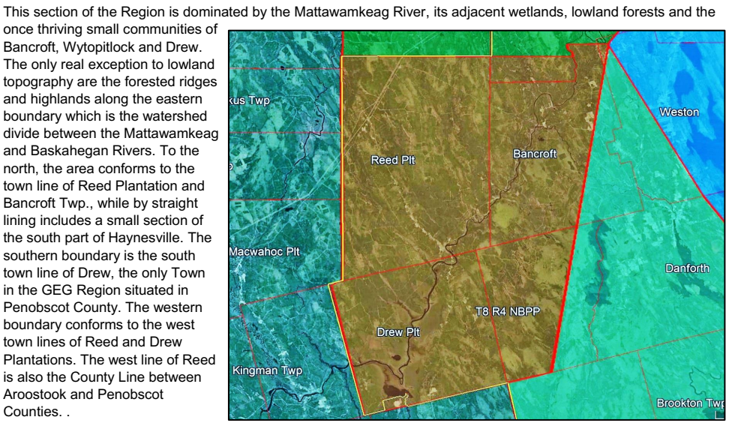
A RIVER – A FOREST & ITS PEOPLE – 100,000 ACRES
The Mattawamkeag River Lowlands

Slide 26
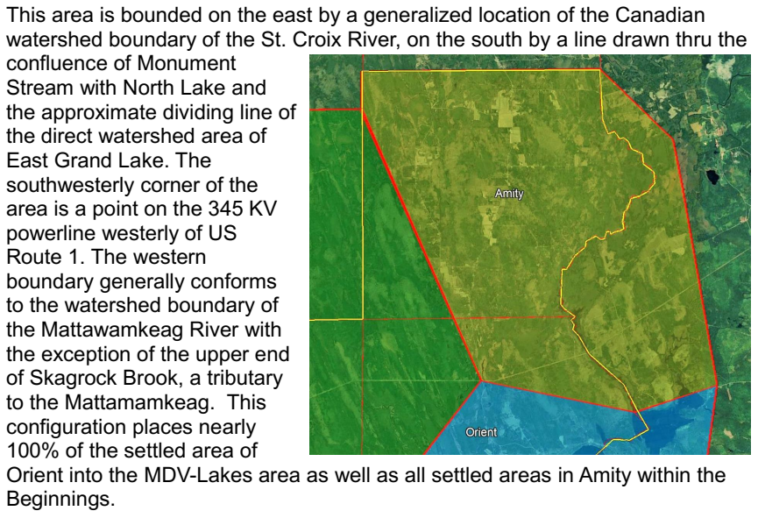
THE BEGINNINGS – 35,000 ACRES
Monument “One” and the Farmlands of Aroostook

Slide 27
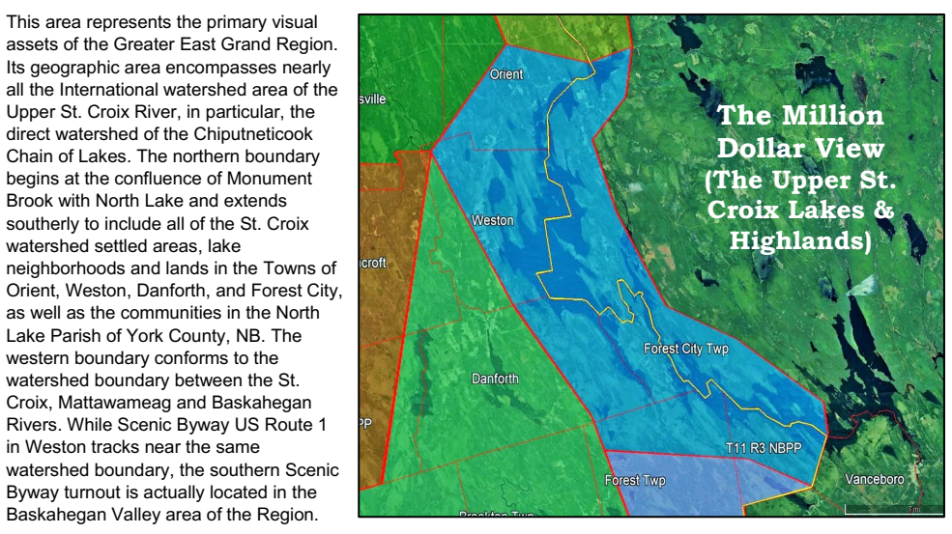
THE MILLION DOLLAR VIEW – 100,000 ACRES Upper Saint Croix River Lakes & Highlands

Slide 28
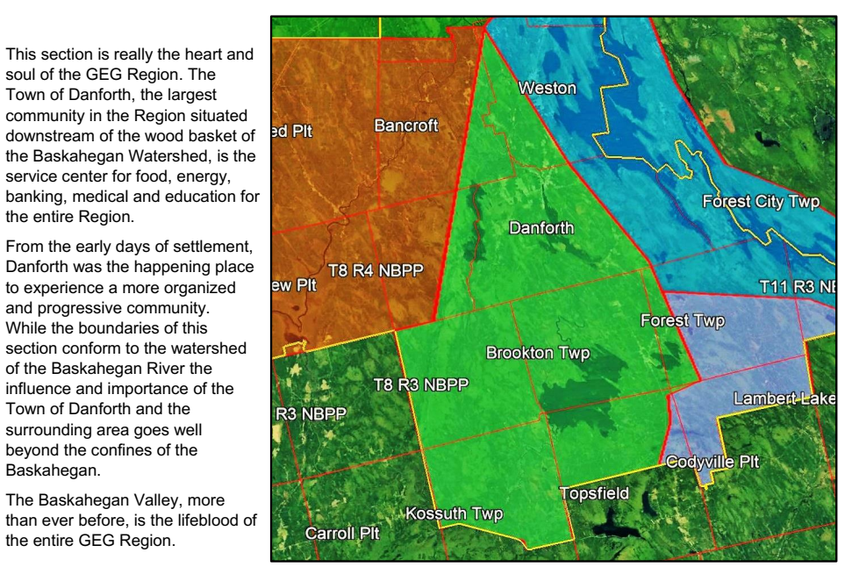
THE BASKAHEGAN VALLEY – 135,000 ACRES Cultural, Historic, Business, Educational, Medical & Entrepreneurial Center of the Region

Slide 29
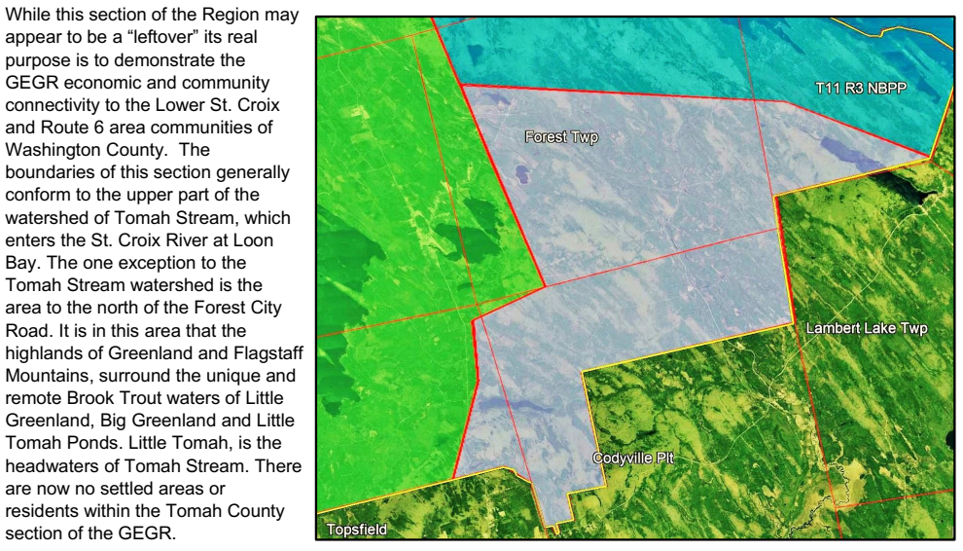
TOMAH COUNTRY – 30,000 ACRES
Connection to the Communities of Route 6 & Lower Washington County

Slide 30
THE FUTURE OF THE GREATER EAST GRAND REGION
The next slide shows how the PA Wilds model might be used to create a vision for the Greater East Grand Region. The following lists some of the very major differences along with similarities: EXCUSE THE PLAGIARISM

Slide 31
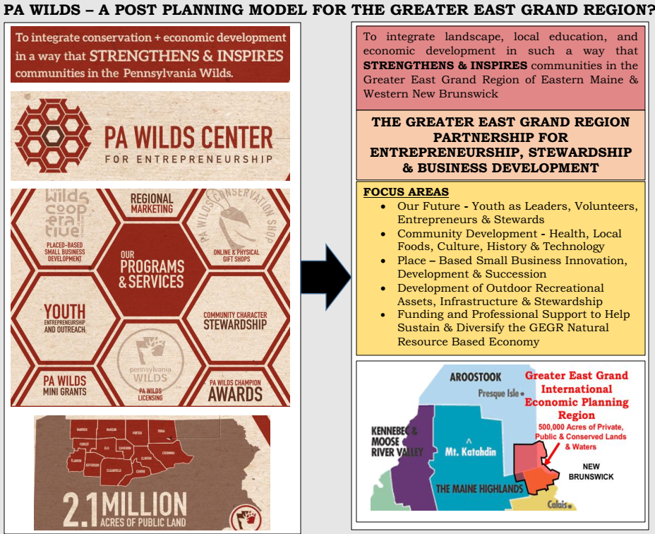

Slide 32
THE FUTURE OF THE GREATER EAST GRAND REGION
Does any of this make sense and/or have application toward a developing a vision for the future for our Region?
See draft expanded descriptions of community areas under separate cover.

