Slide 1
Site Vist & Photo Reconnaissance of Lands at Confluence of Baskahegan & Mattawamkeag Rivers
Elbridge Cleaves
June 11, 2019

Slide 2
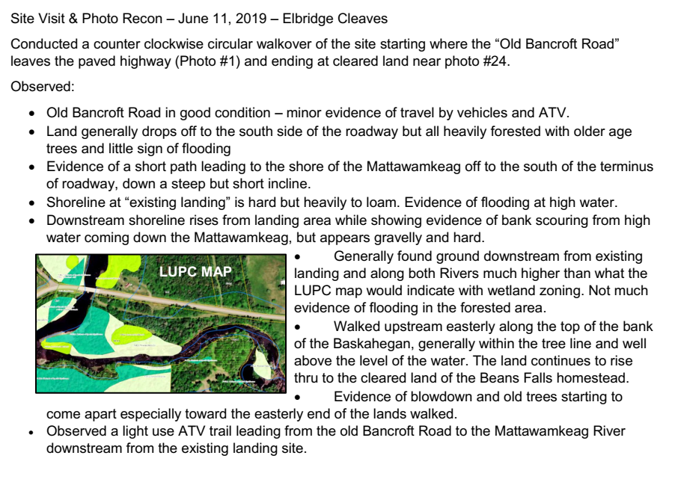

Slide 3
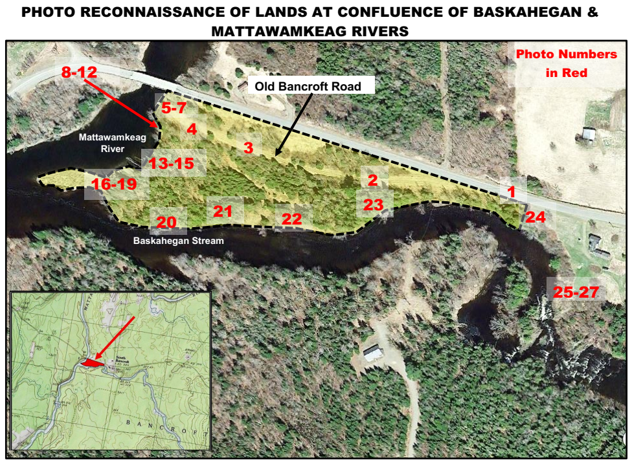

Slide 4
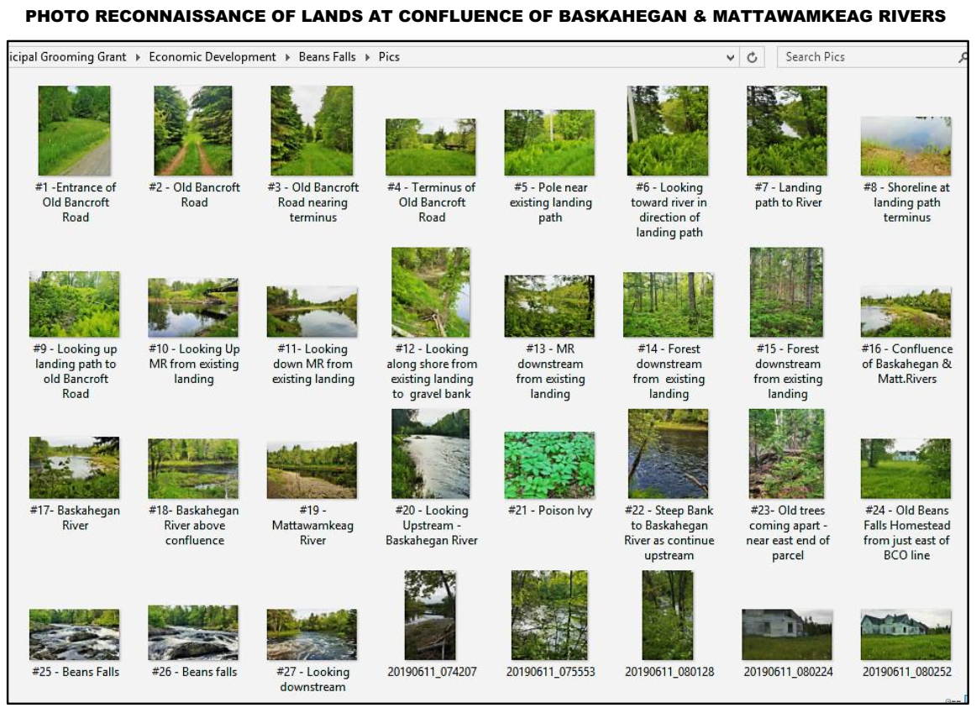

Slide 5
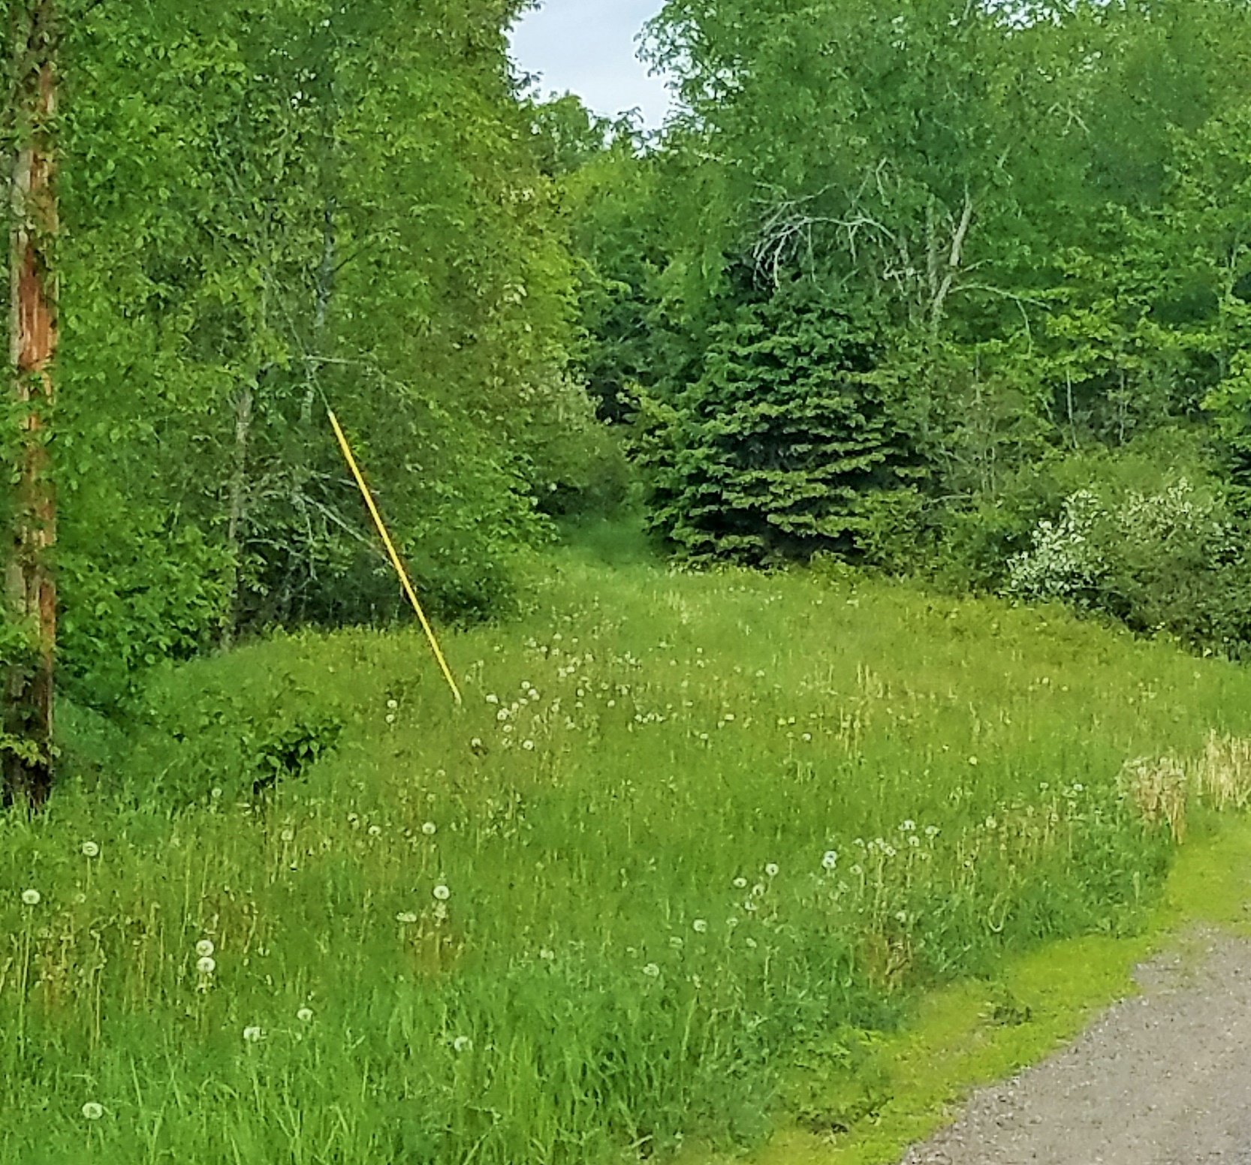
#1 – Entrance of Old Bancroft Road

Slide 6
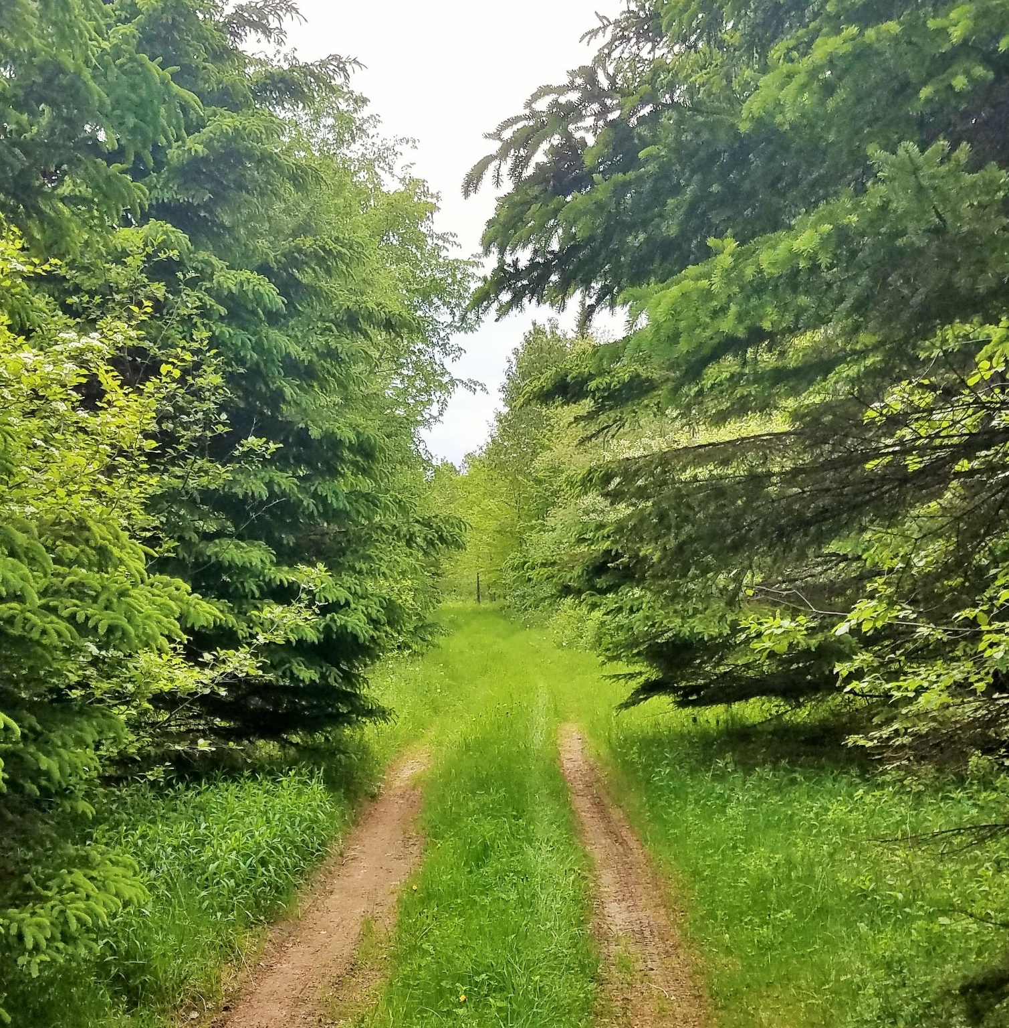
#2- Old Bancroft Road

Slide 7
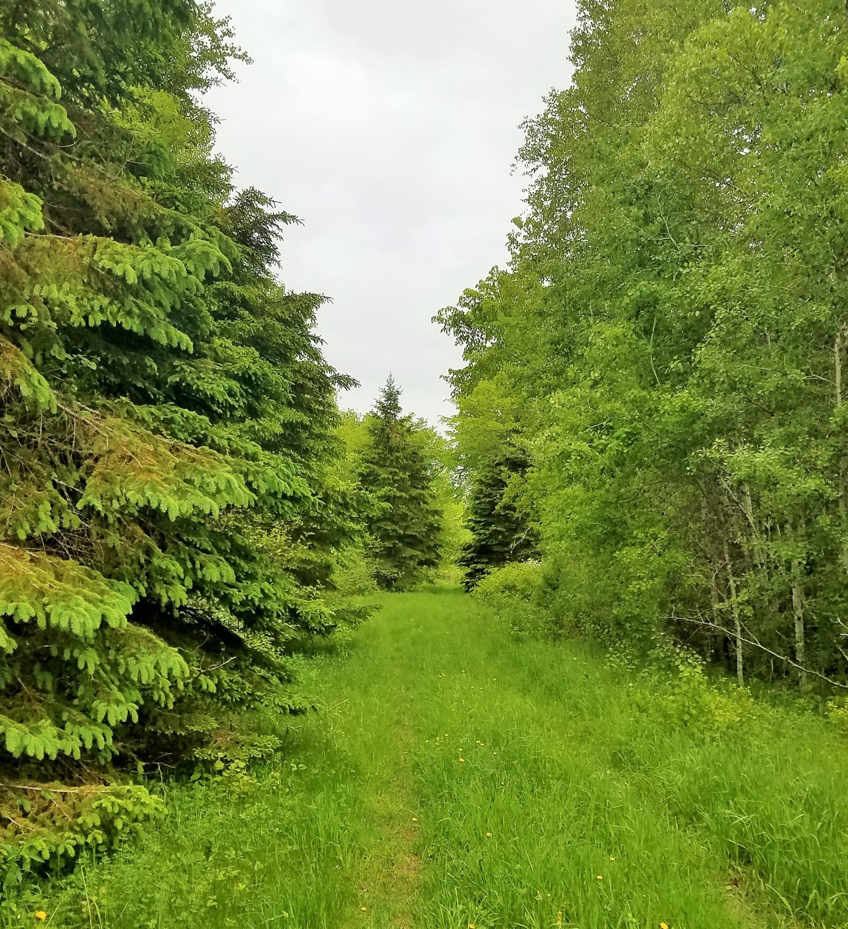
#3- Old Bancroft Road

Slide 8
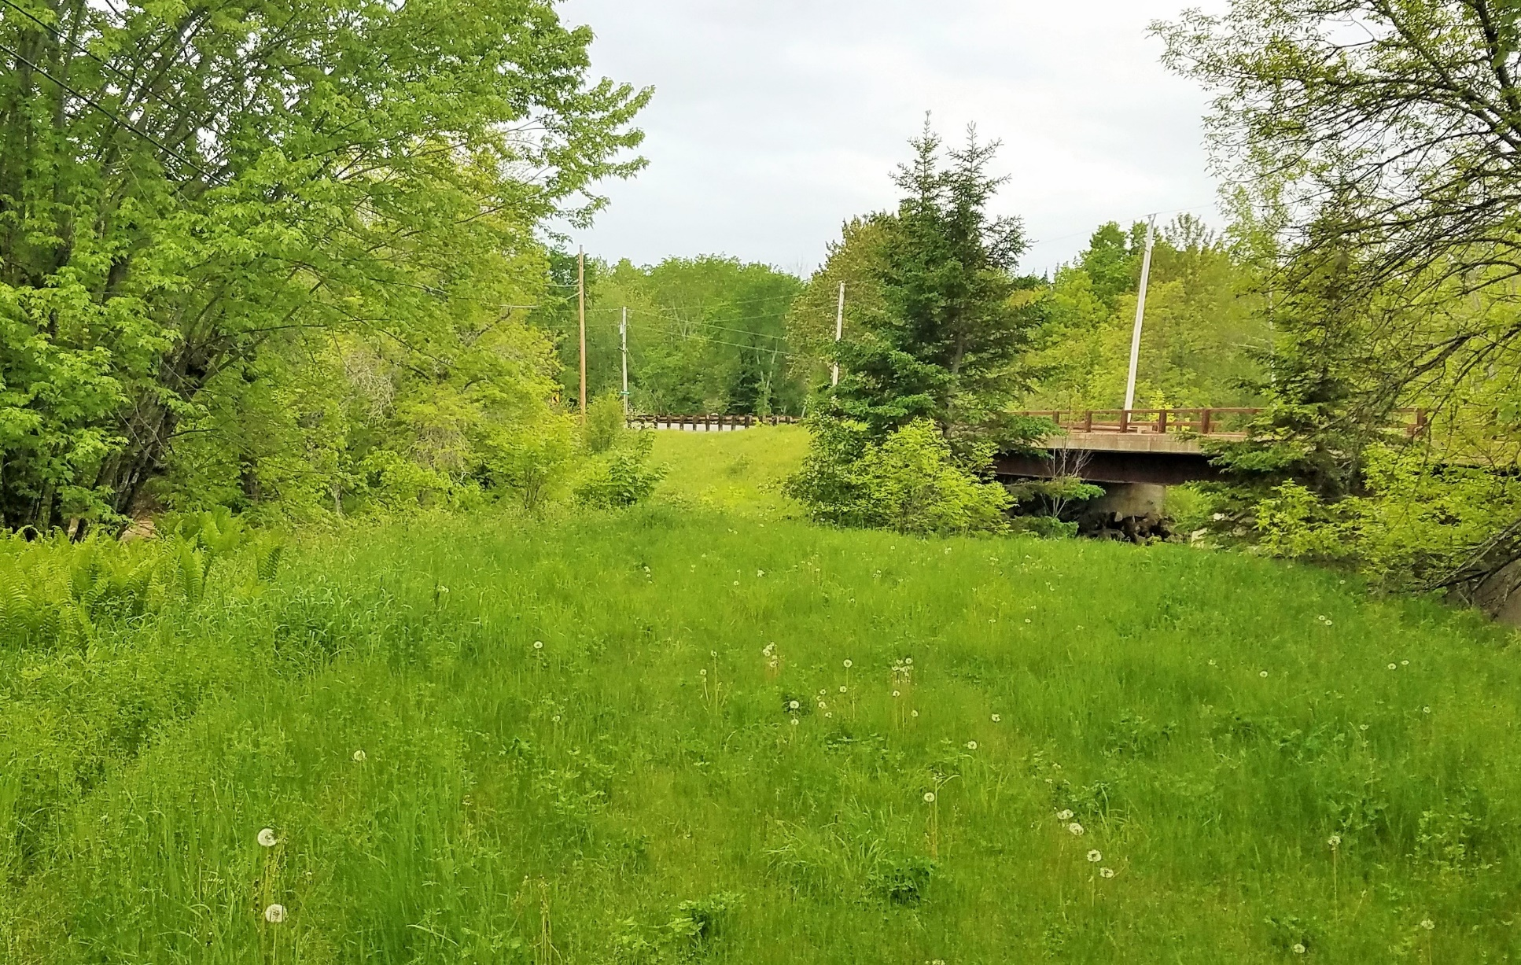
#4- Near Terminus of Old Bancroft Road

Slide 9
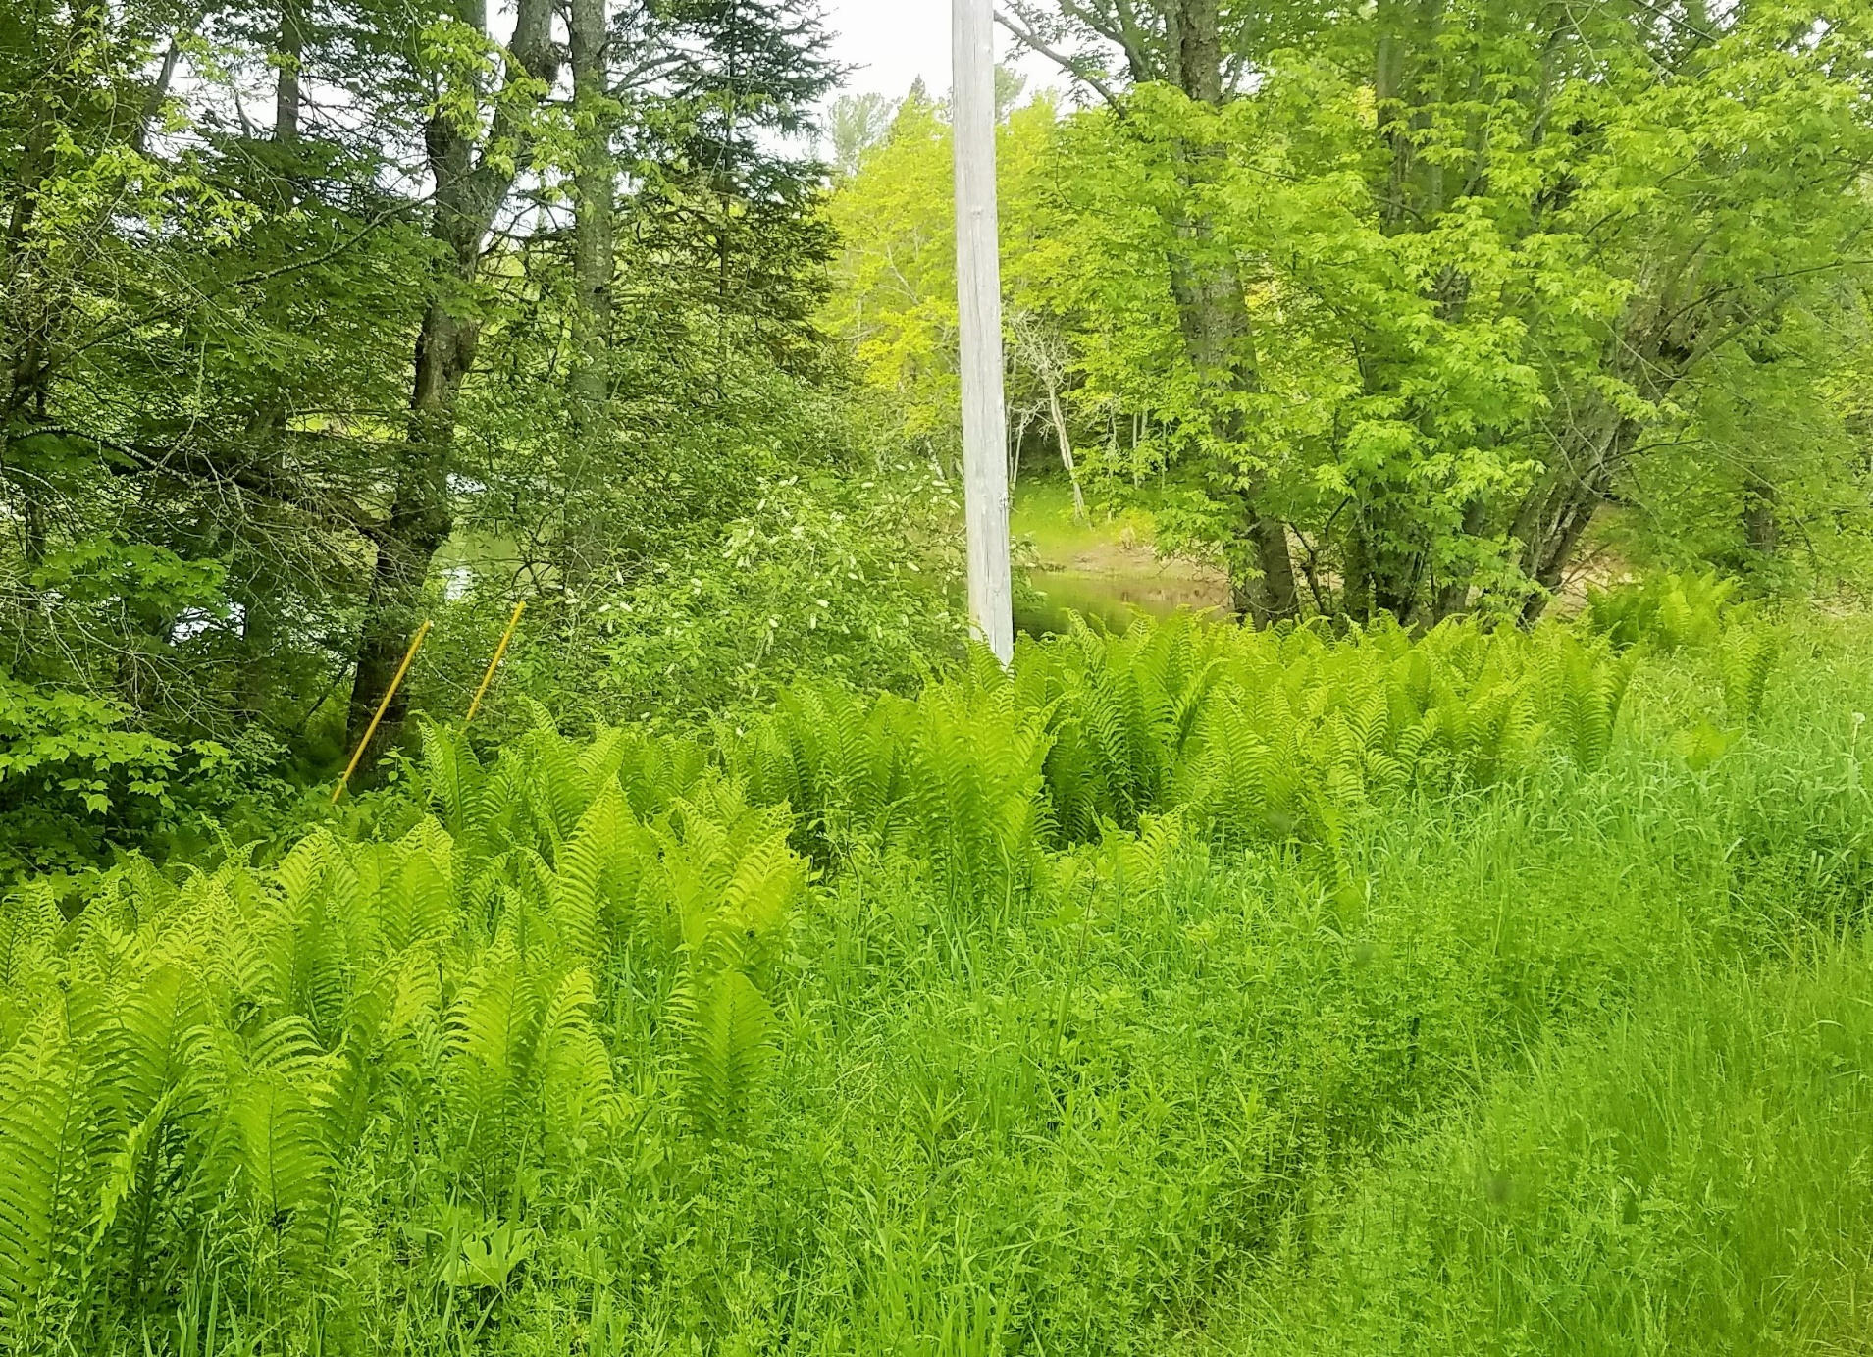
Existing Landing
#5- Power Pole Old Bancroft Road

Slide 10
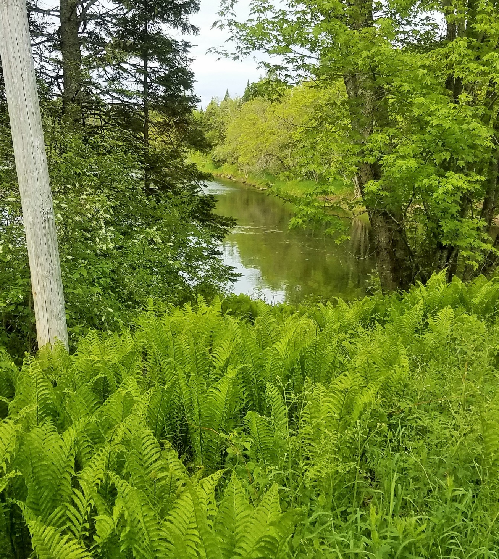
#6- Looking toward River in
direction of path to landing

Slide 11
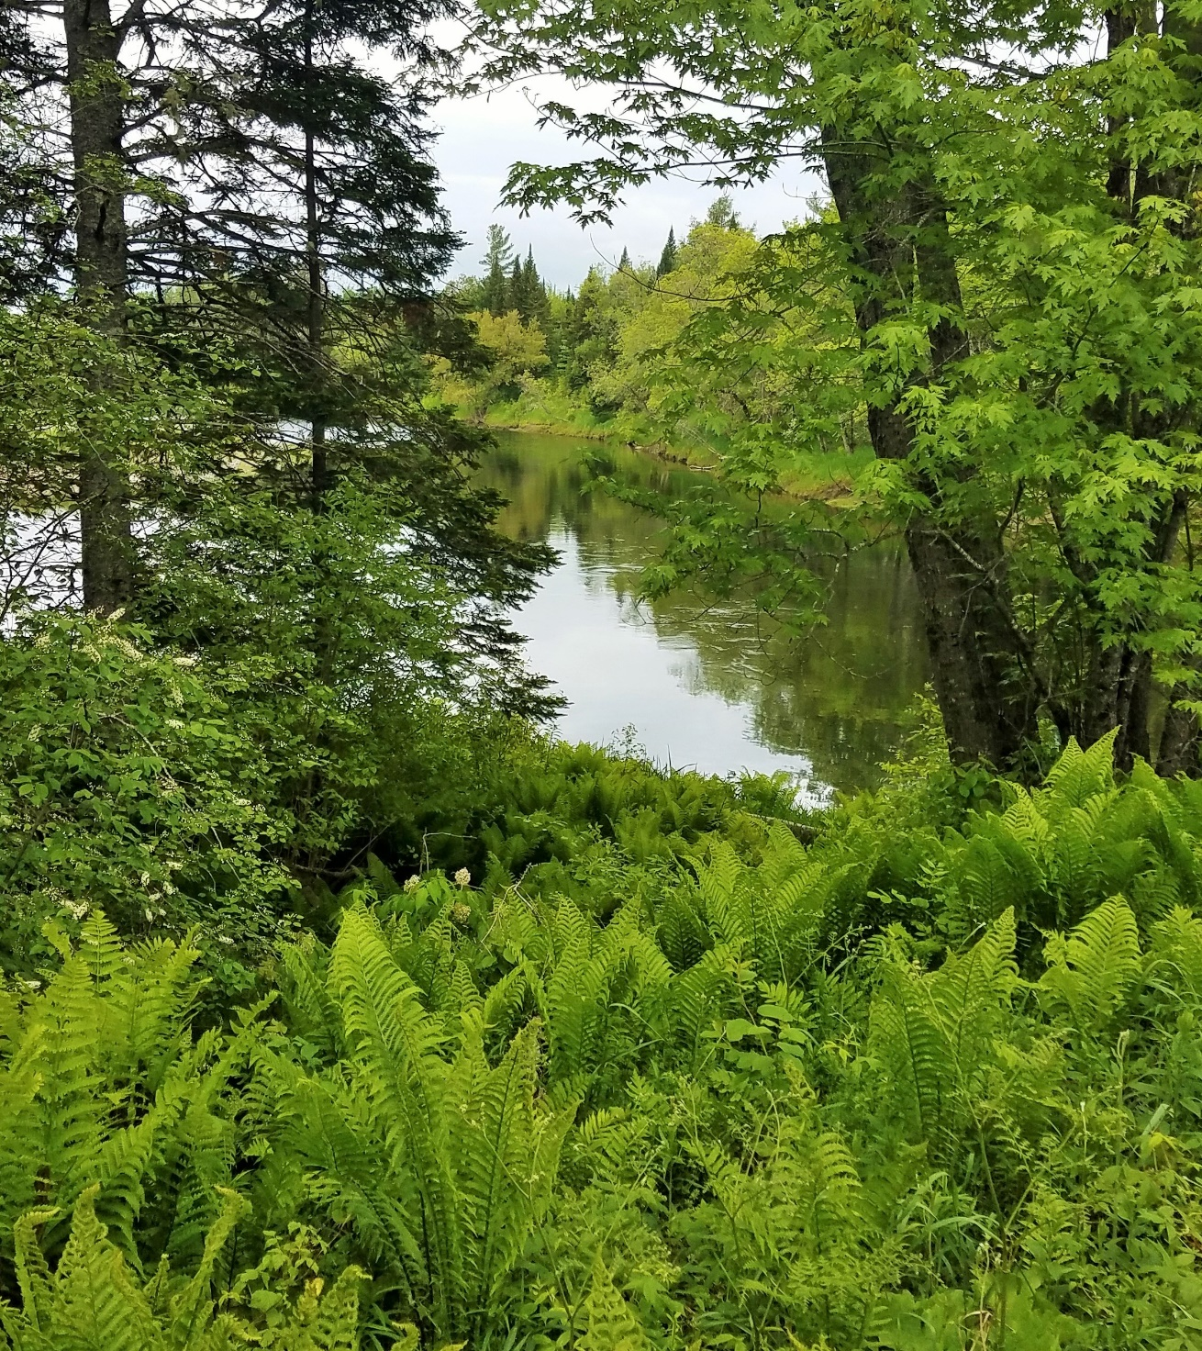
#7- Looking down path to landing

Slide 12
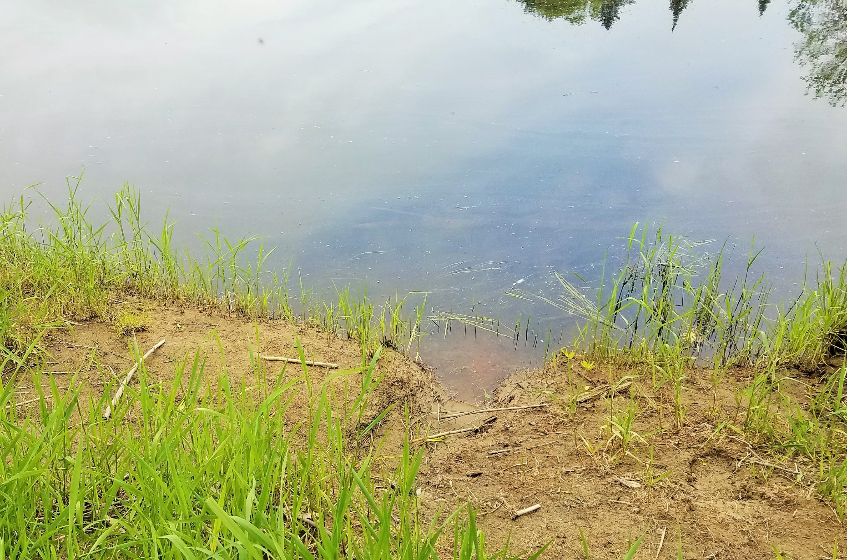
#8- Shoreline at landing area

Slide 13
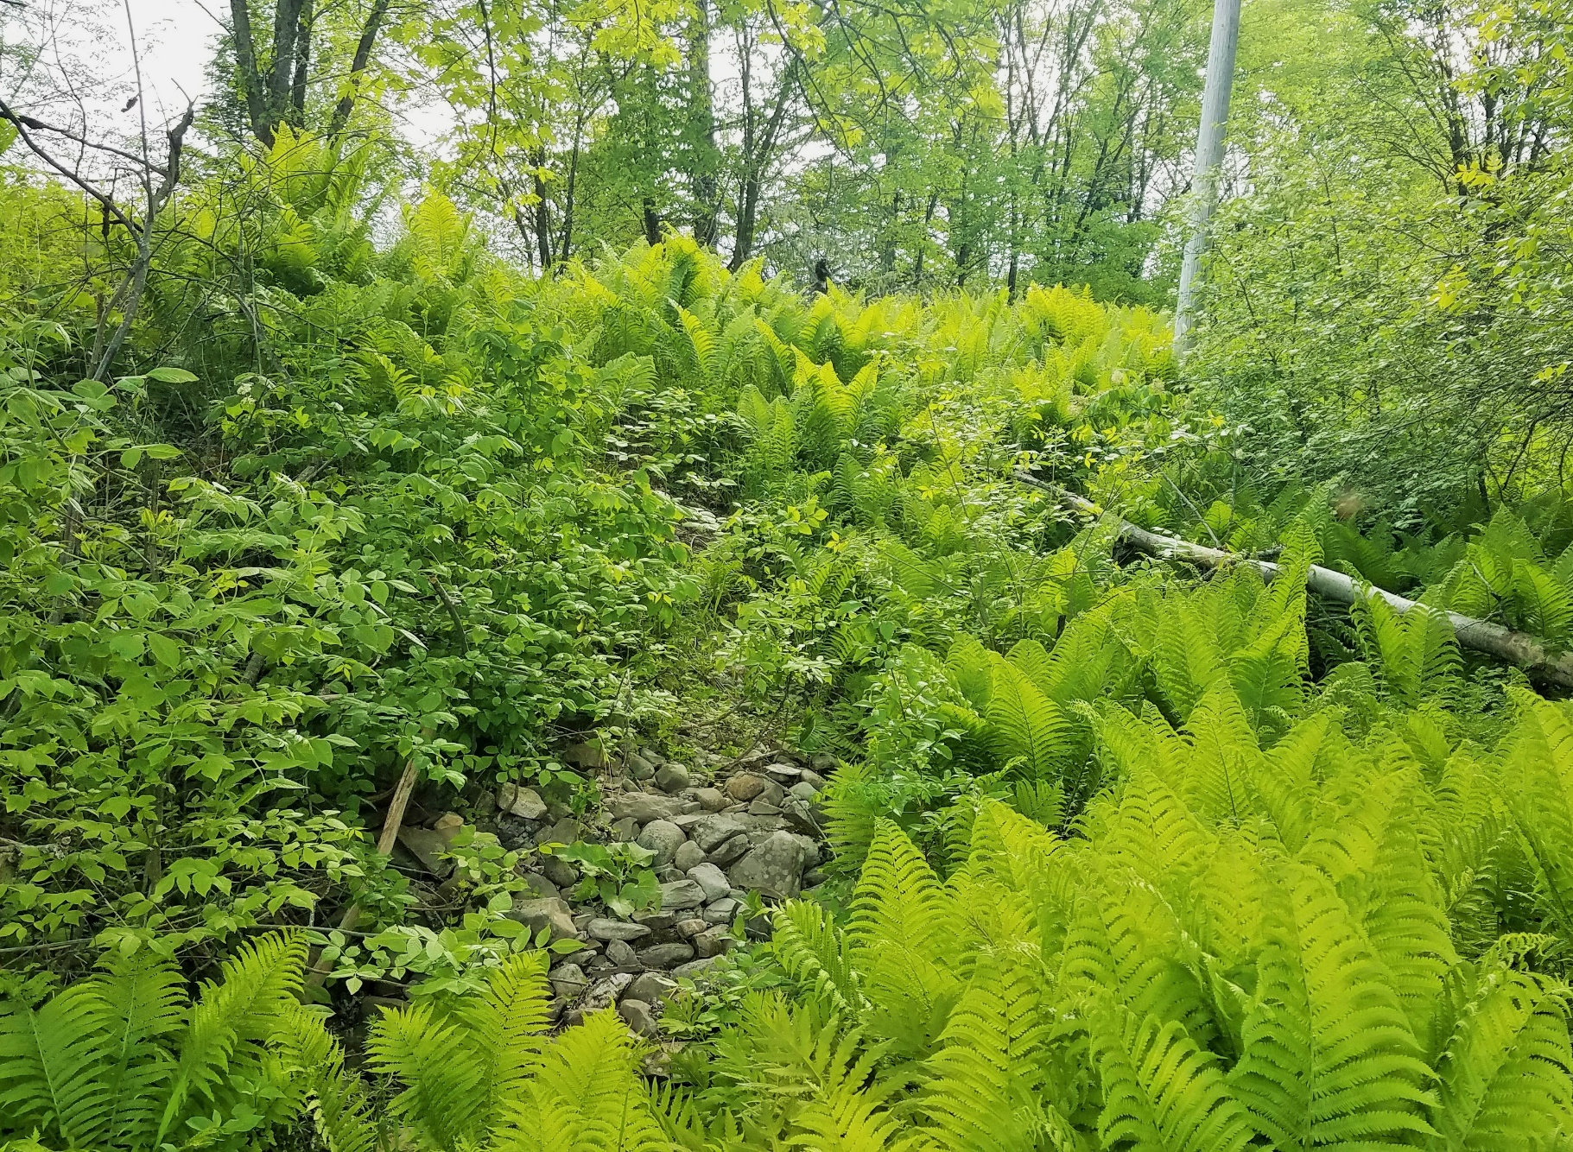
#9- Looking up slope from landing to old Bancroft Road

Slide 14
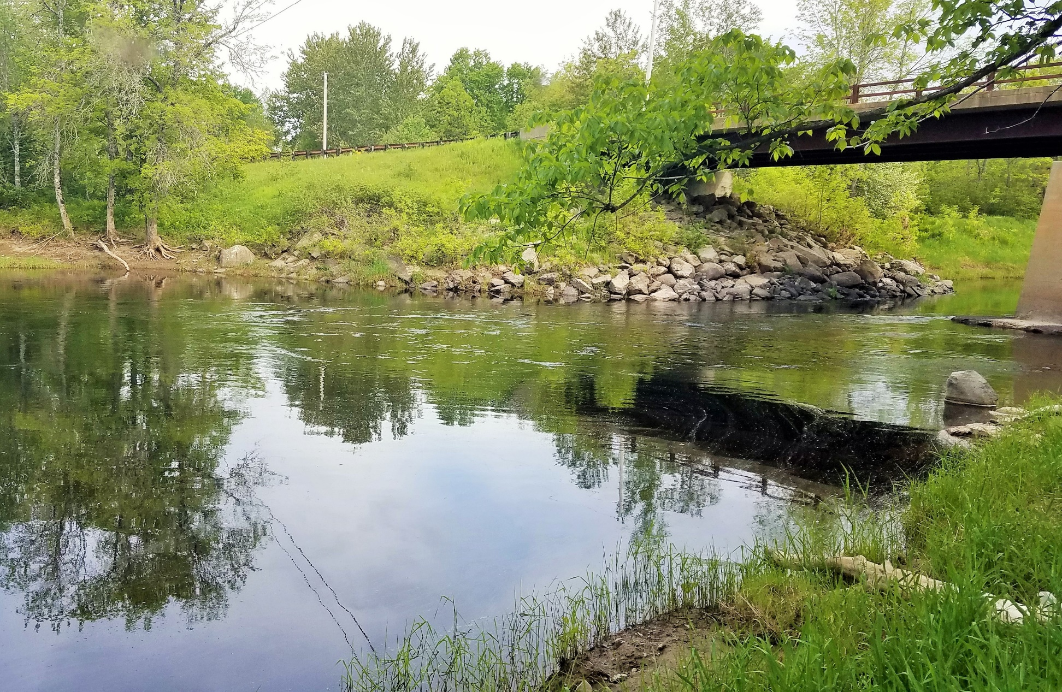
#10- Looking upstream from landing area

Slide 15
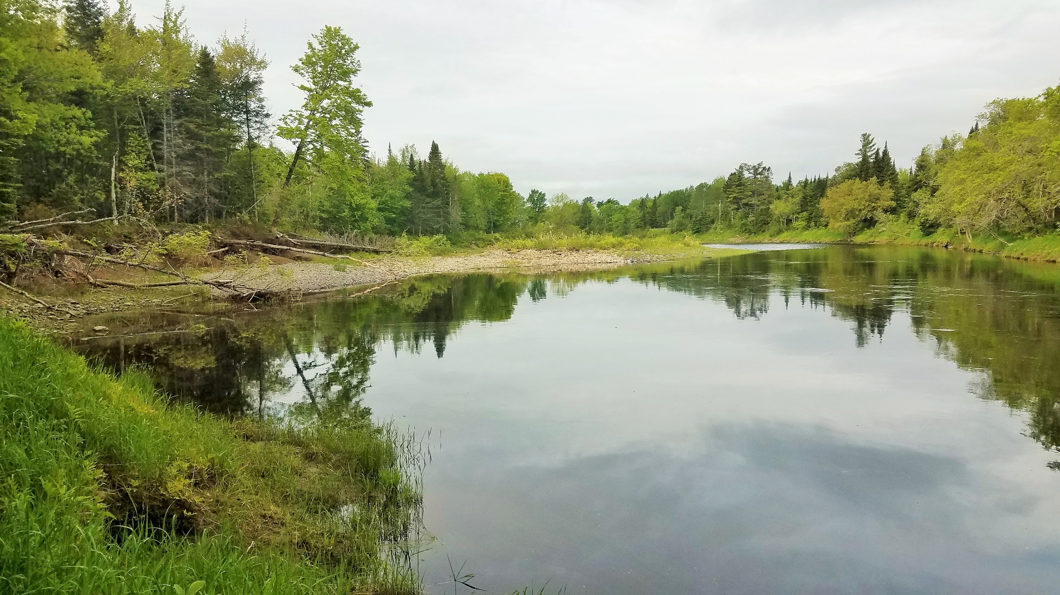
#11- Looking downstream from landing area

Slide 16
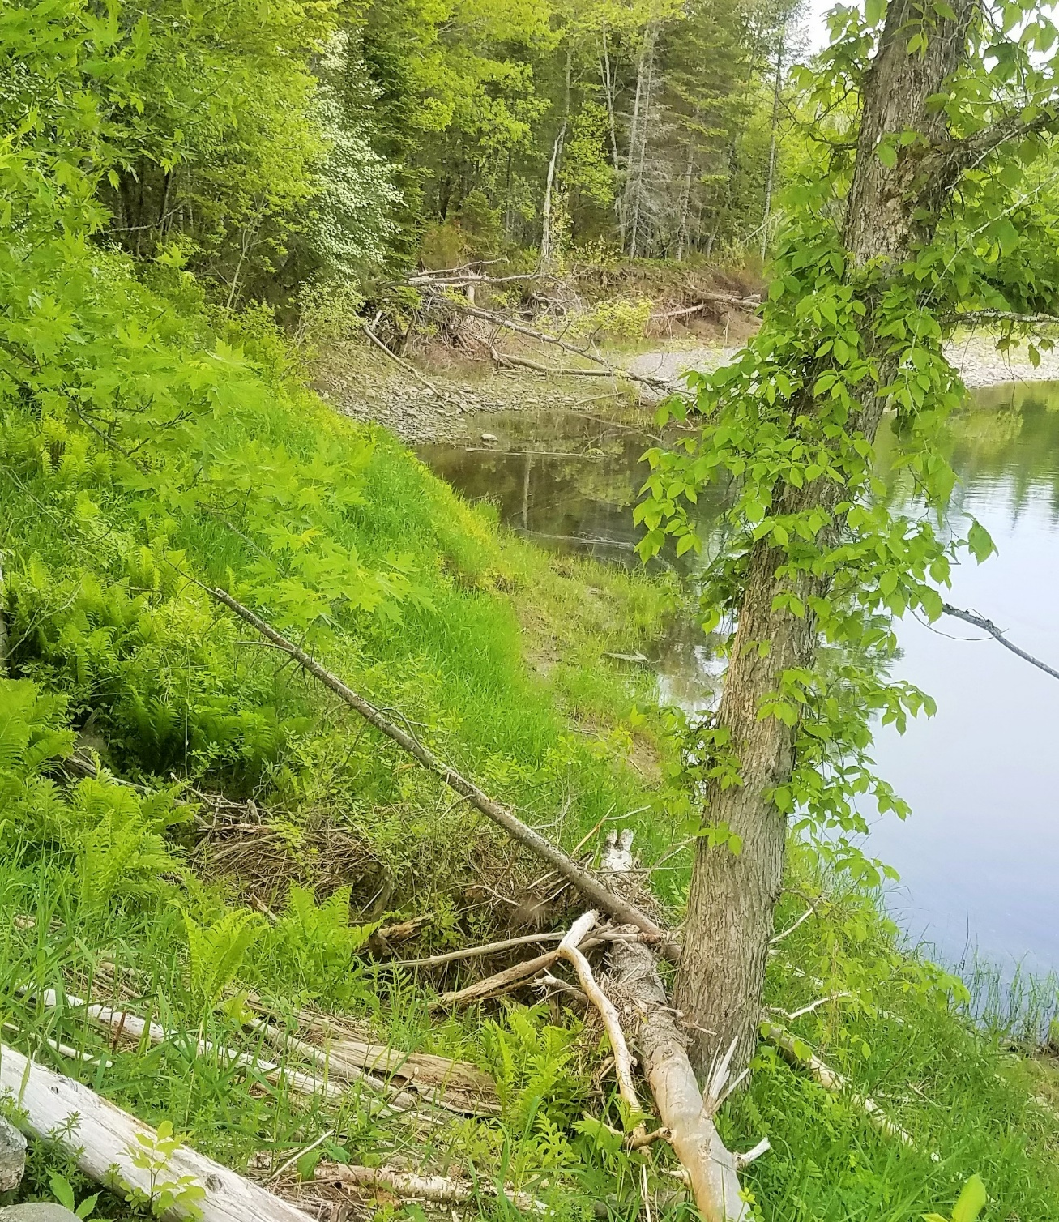
Existing Landing
#12- Looking along shore downstream from landing area

Slide 17
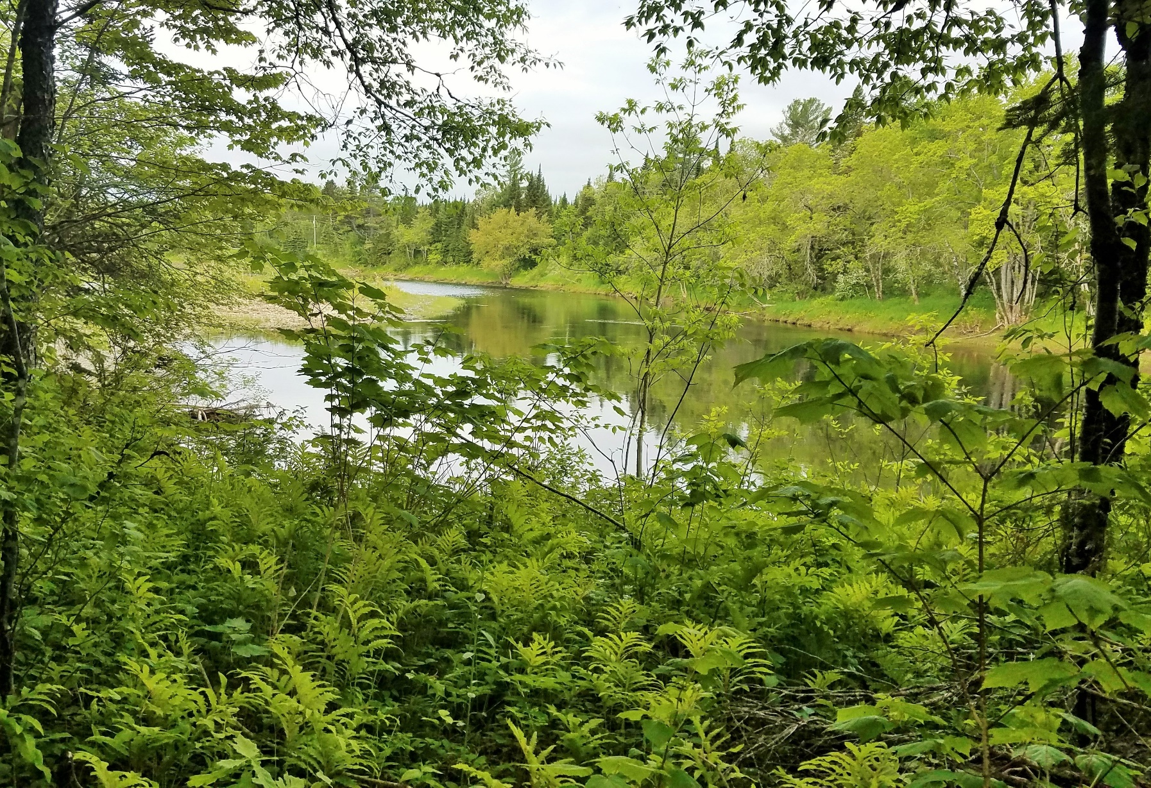
#13- Mattawamkeag River downstream from landing area

Slide 18
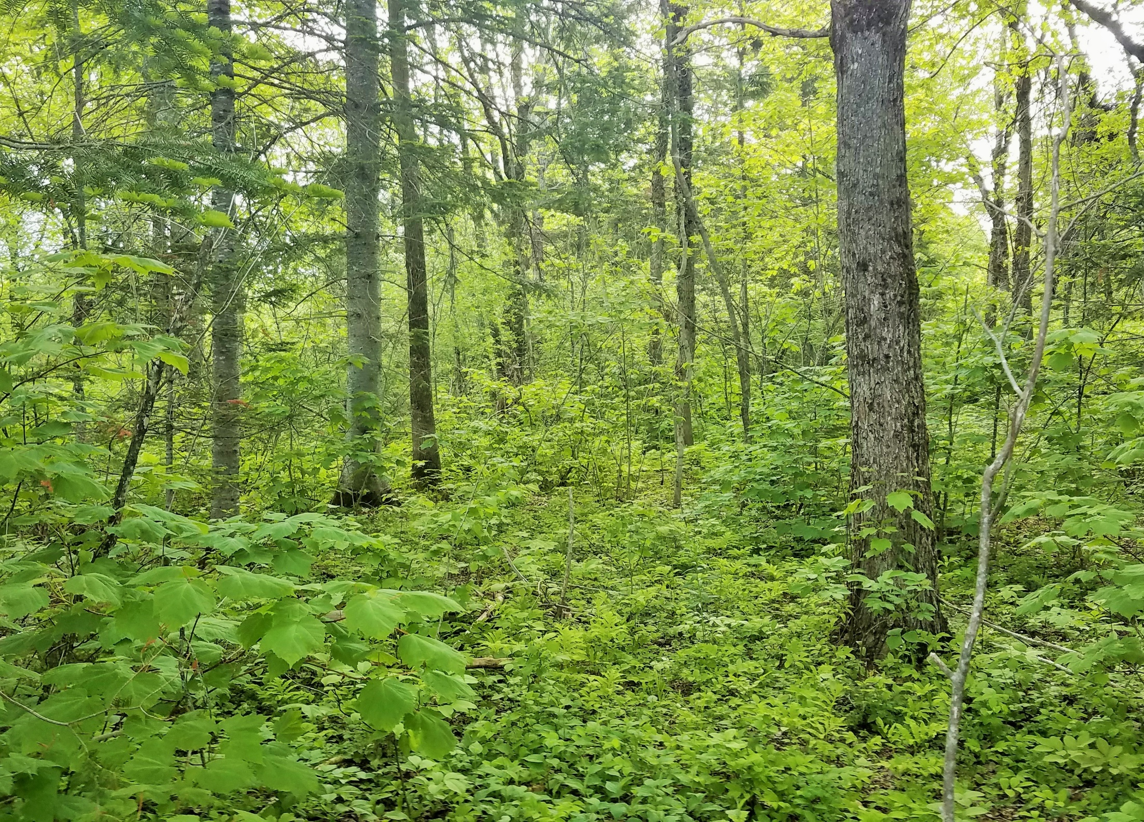
#14- The forest along Mattawamkeag River downstream from landing area

Slide 19
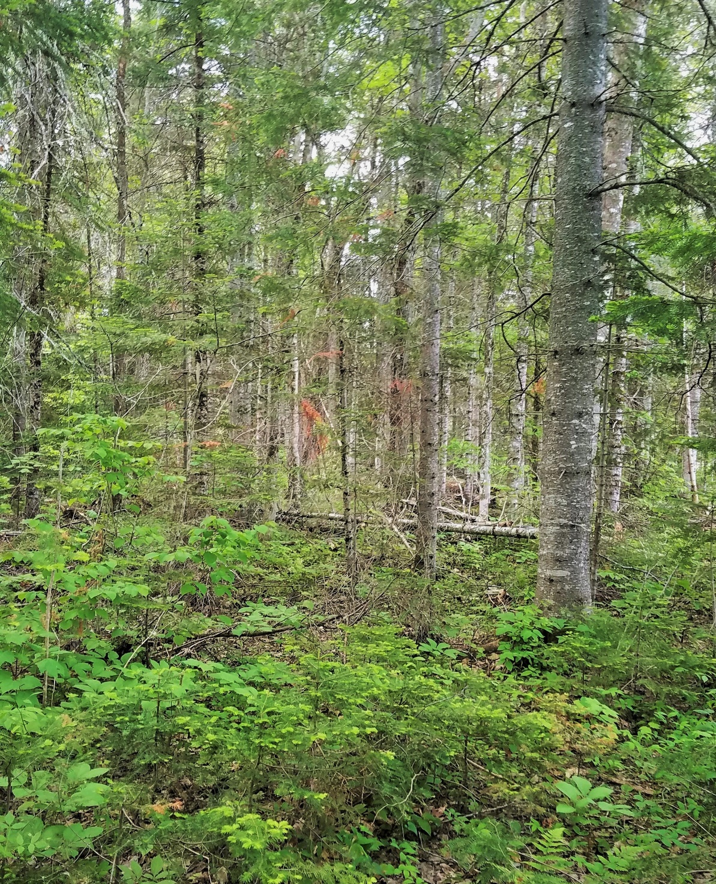
#15- The forest near confluence of Rivers

Slide 20
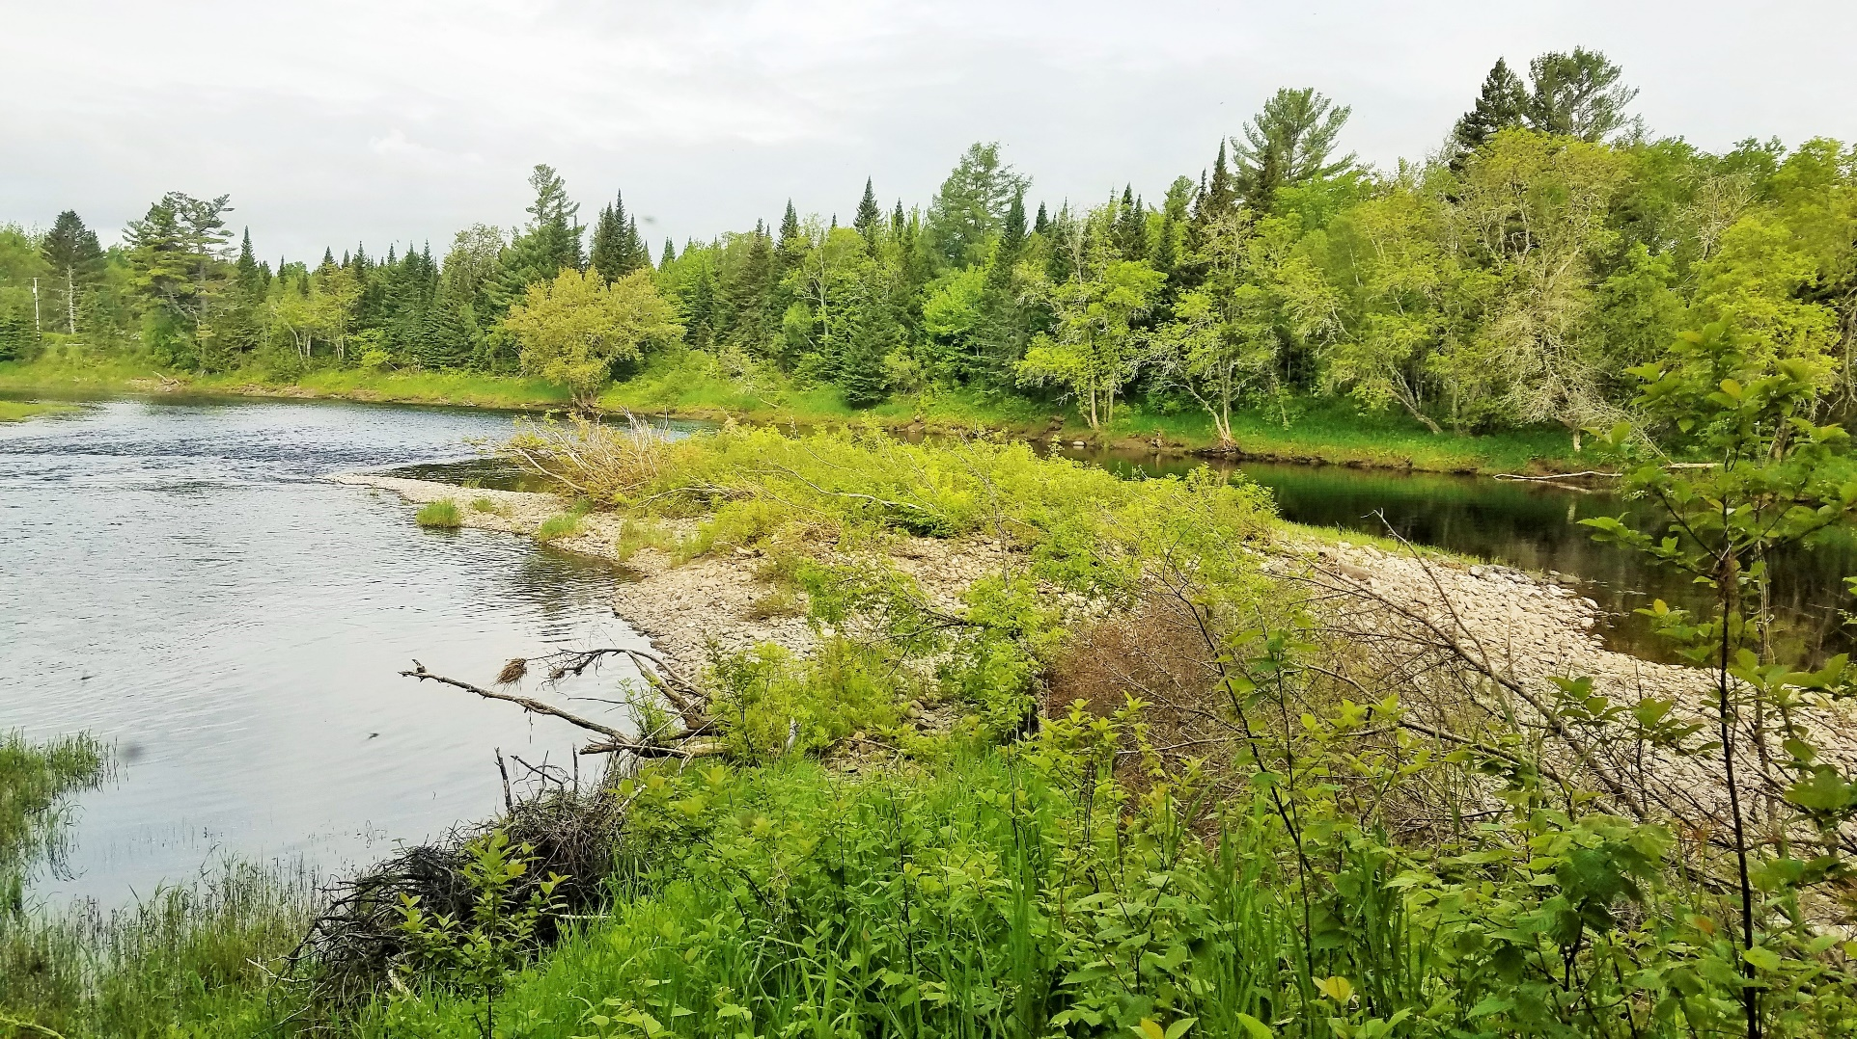
#16- Confluence of the Mattawamkeag and Baskahegan Rivers.

Slide 21
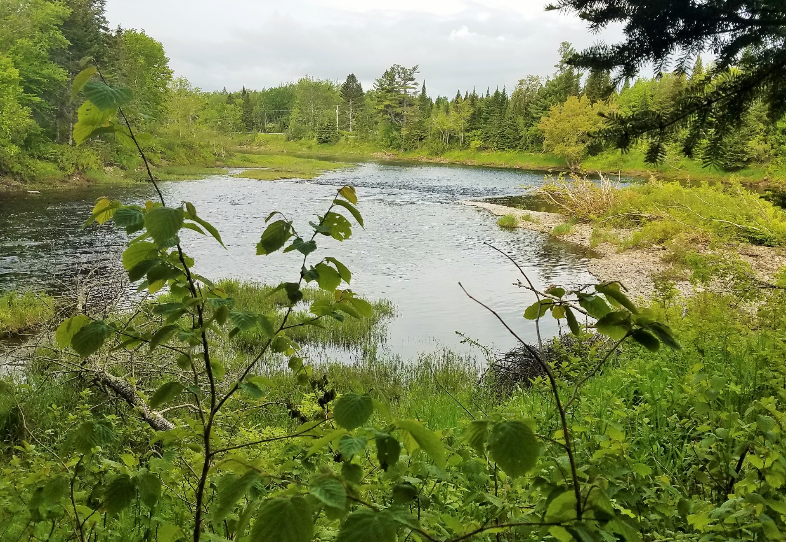
#17- The Baskahegan River

Slide 22
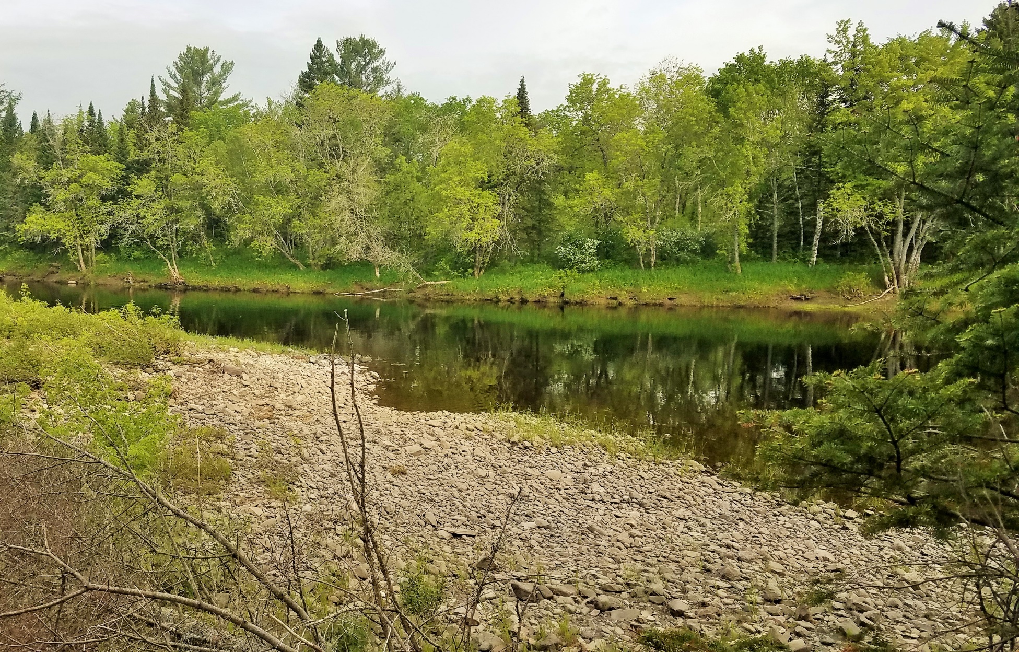
#18- The Mattawamkeag River

Slide 23
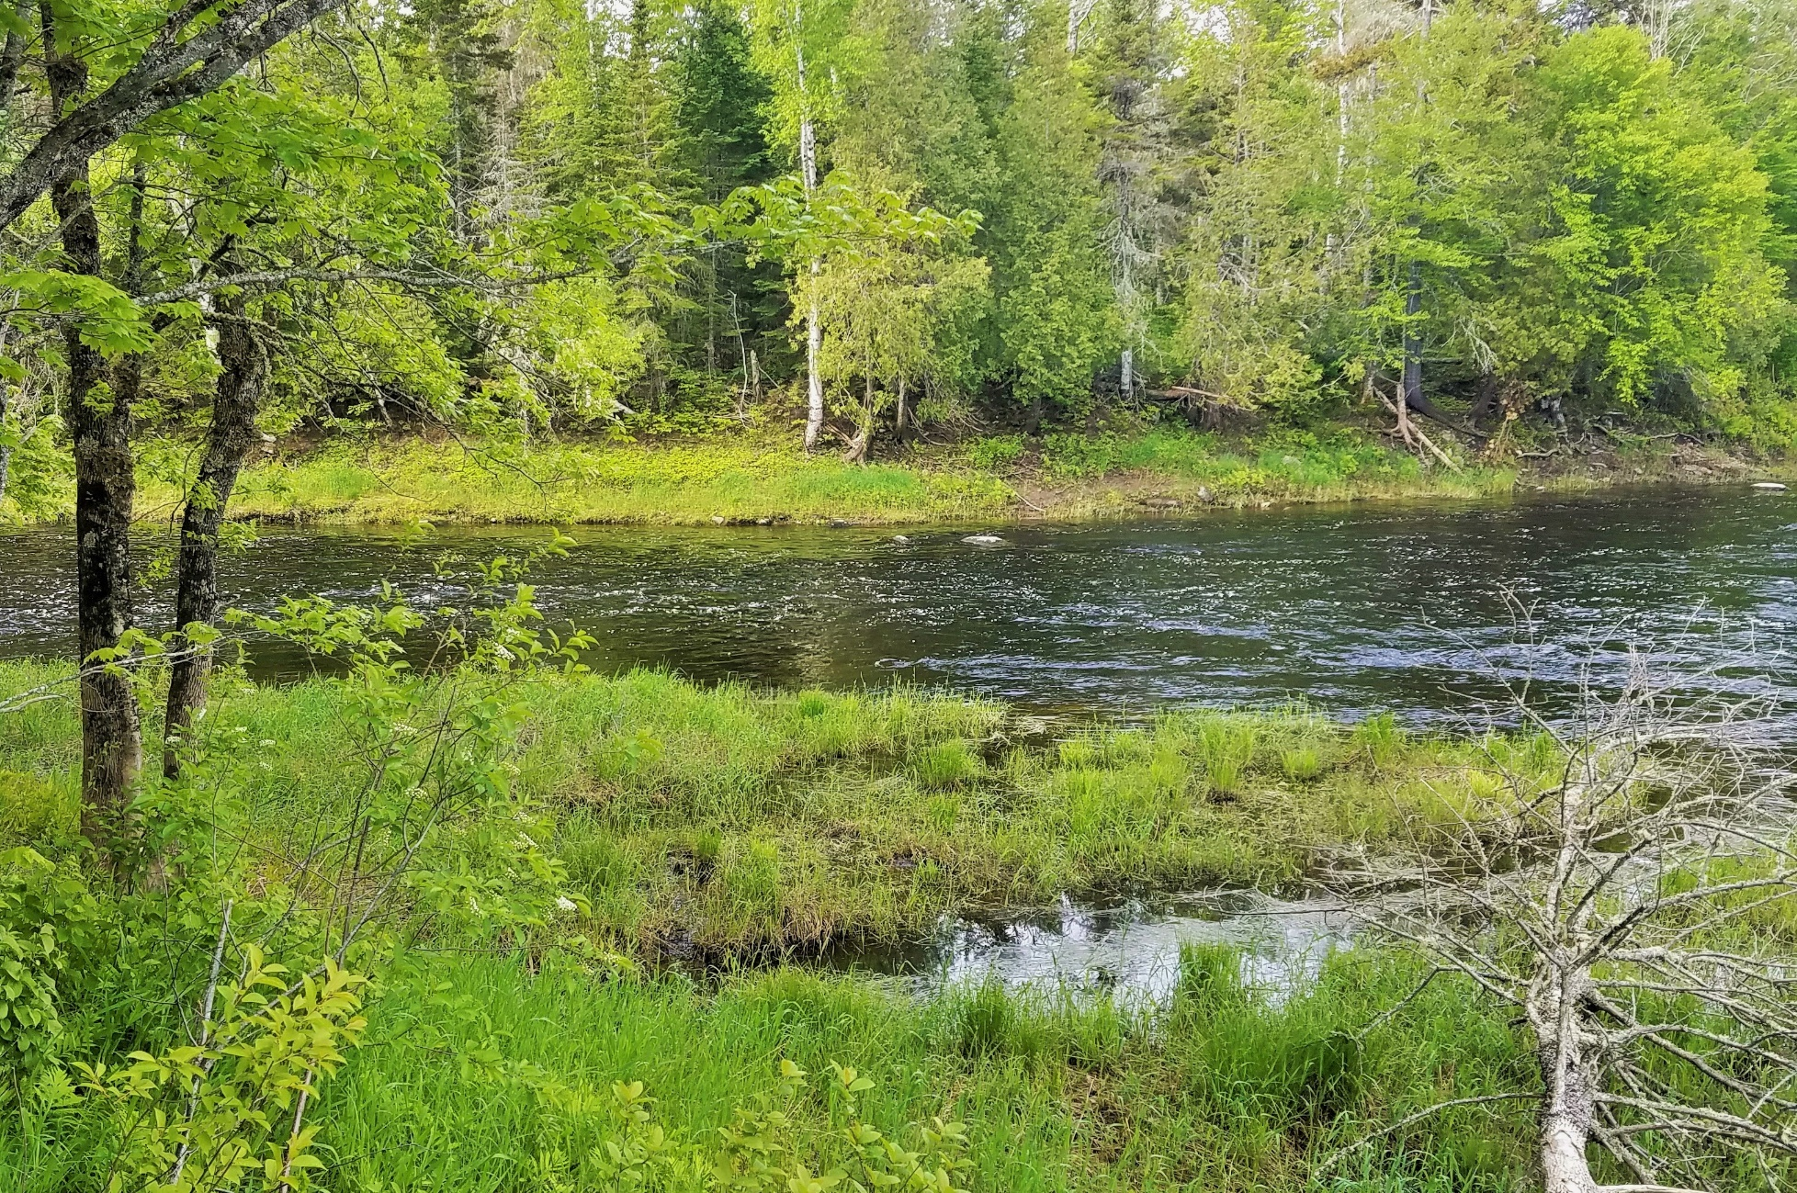
#19- The Baskahegan above confluence with Mattawamkeag

Slide 24
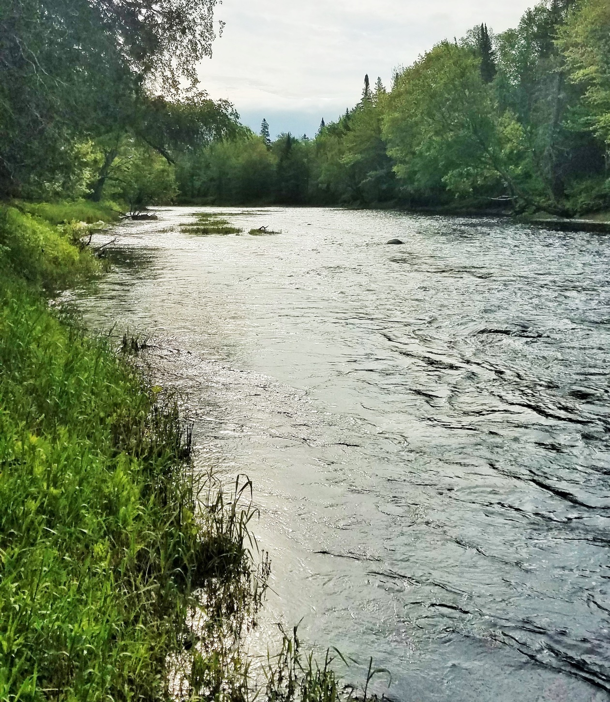
#20- The Baskahegan looking upstream above confluence with Mattawamkeag

Slide 25
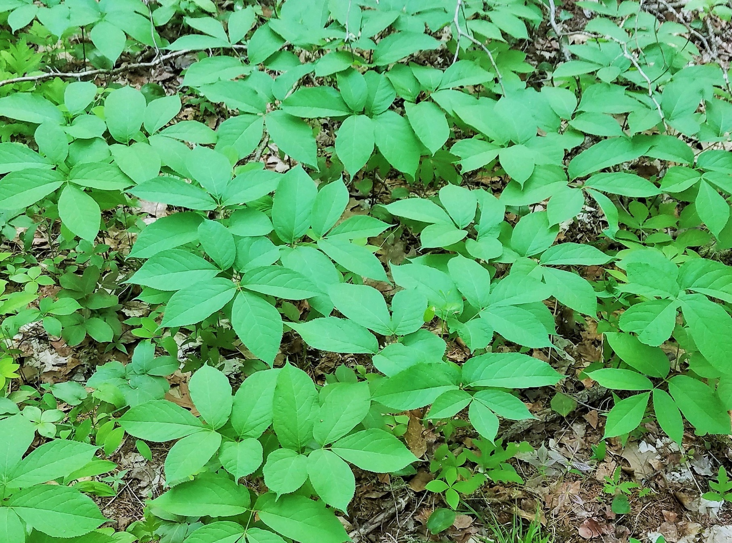
#21- What appears to be a patch of Poisen Ivy near the Baskahegan - upstream from confluence with Mattawamkeag

Slide 26
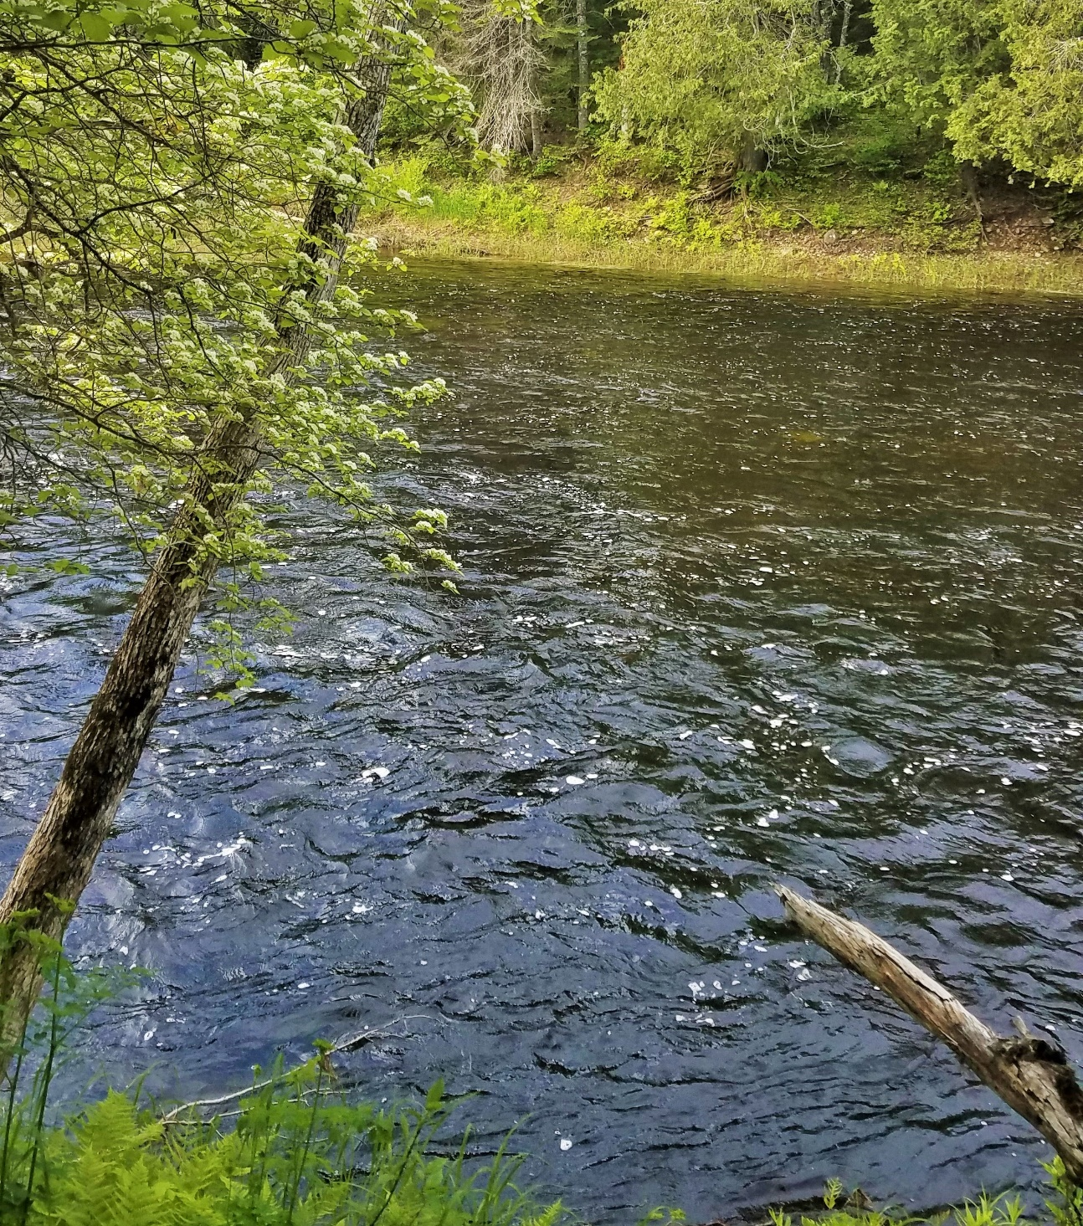
#22- The Baskahegan – steep bank down to the water

Slide 27
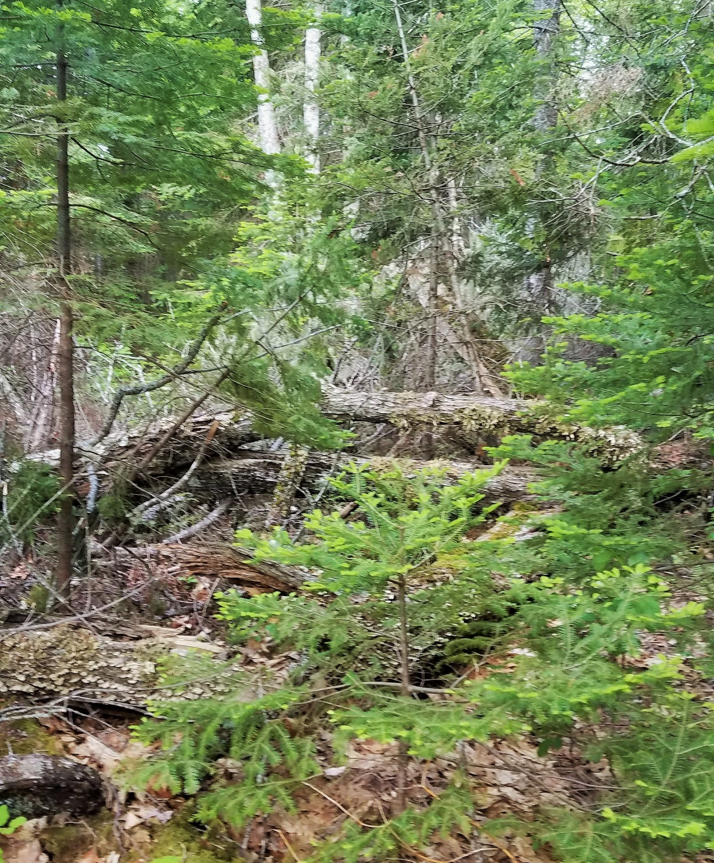
#23- Old trees and blowdown along Baskahegan near east end of lands

Slide 28
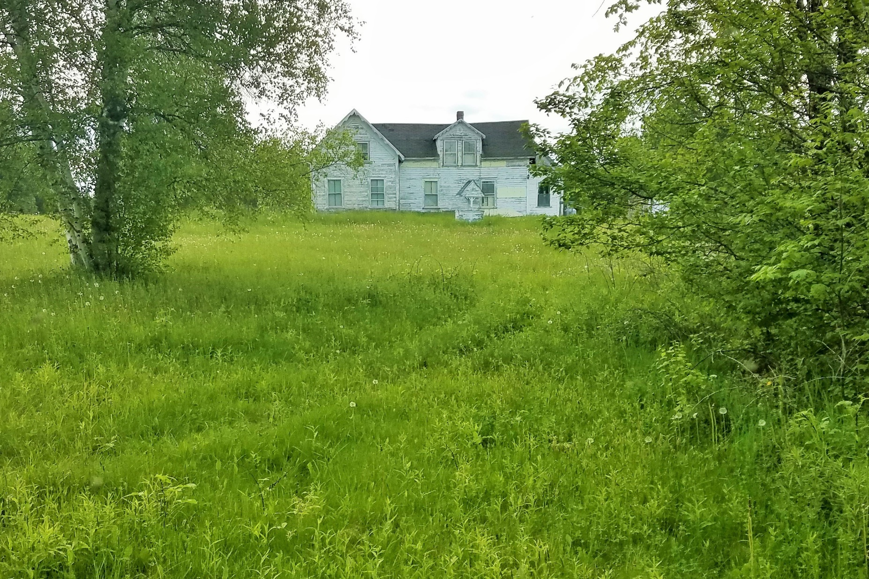
#24- Old Beans Falls Homestead east of lands

Slide 29
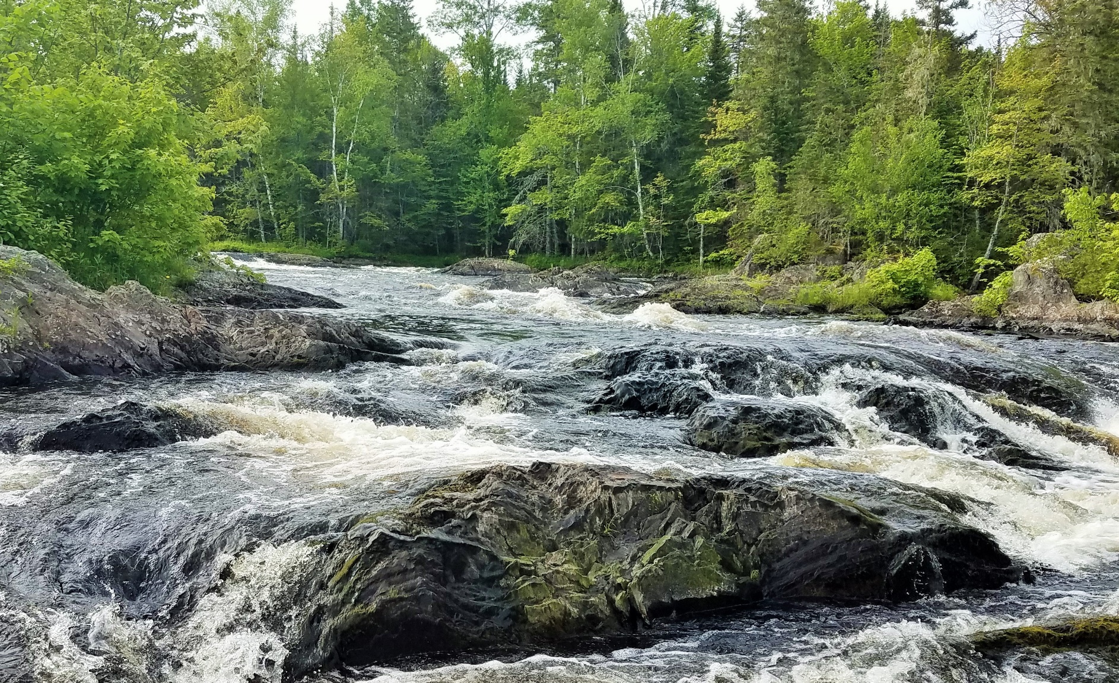
#25- Beans Falls

Slide 30
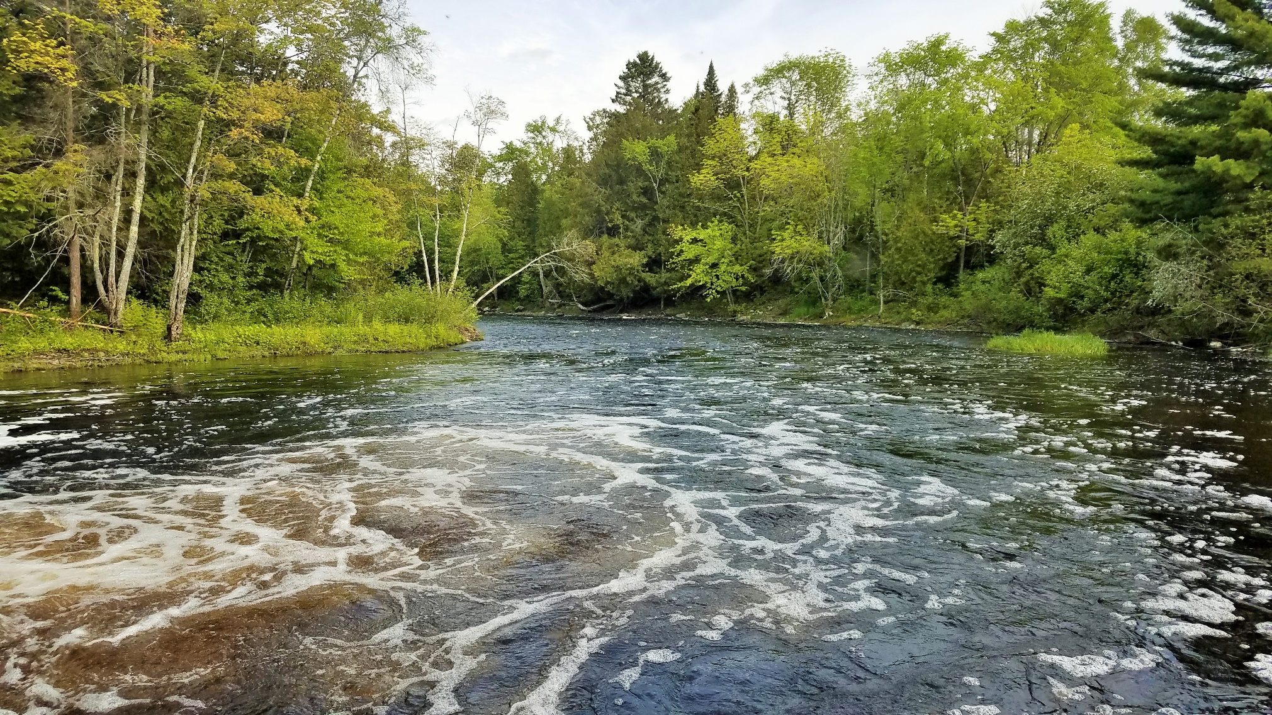
#26- Looking downstream from Beans Falls

